Slide 1

IW:LEARN
TDA/SAP Training Course
Module 2: Development of the TDA

Slide 2
Overview of the Training Course
4 Modules:
  Module 1: Introduction
  Module 2:Developing the TDA
  Module 3: Formulating the SAP
  Module 4: Managing the TDA/SAP process

Slide 3
Overview of Today
AM
  Opening
  Module 2: Developing the TDA – Causal Chain Analysis
  PM
  Module 2: Developing the TDA – Drafting the TDA
  Group discussion
  Break
  Group Exercise
  Module 2: Developing the TDA – Thematic Reports
  Module 2: Developing the TDA – TDA-SAP Linkage
  Group Exercise
  Break
  Module 3: Developing the SAP – Introduction and Setting a Vision
  Group Exercise
  Closing
  LUNCH
  END

Slide 4
Section 7: Thematic Reports

Slide 5
Analysis

Slide 6
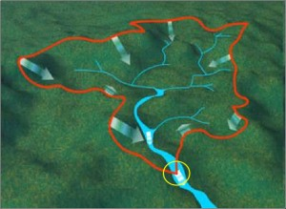

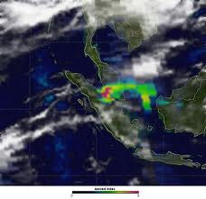

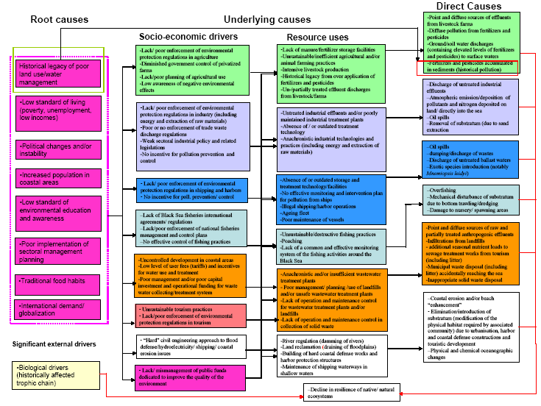

Where are we?
Defining system boundaries
Collection
and analysis of data/information
Identification
&
prioritisation
of the transboundary problems
Determination of the
impacts of each priority problem
Analysis
of the immediate, underlying, and root causes for each problem
Development of thematic reports

Slide 7
In this Section you will learn about….
What are thematic or synthesis reports?
A process for developing thematic or synthesis reports
Advice from the field

Slide 8
Thematic Reports
The main source of supporting information for the TDA will be thematic (synthesis) or national reports
These are likely to be drafted by selected consultants or national experts from the TDA development team with each report using a similar structure

Slide 9




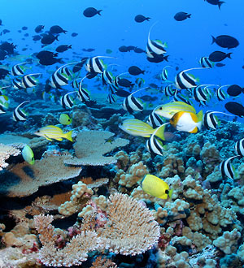
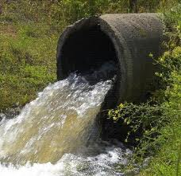
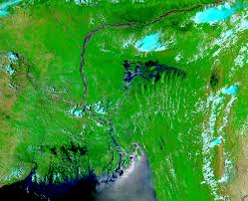
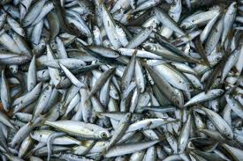
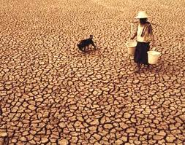
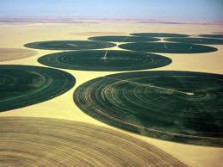
Broader studies on aspects of the TDA
Governance
Analysis
Stakeholder
Analysis
Causal Chain
Analysis
Gender
Analysis
Climate
Change
Specific reports on transboundary problems
Biodiversity
Pollution
Flooding
Fisheries
Drought
Water use

Slide 10
Process for developing thematic reports
Step 2: Report development and review
Step 1: Identification of the key areas for reporting and appropriate national experts to develop the reports

Slide 11
Step 1: Identification of key areas and national experts
The Project Manager and TDA Development Team will need to identify the key areas for reporting, based on the prioritised transboundary problems, their impacts and causes
In addition, they will also need to identify suitable candidates to develop each report.

Slide 12
Step 1: Identification of key areas and national experts
Candidates could be members of the Development Team or recommended by the Development Team
Terms of Reference (ToR) for each Report will need to de developed and it is recommended that each ToR and report use a similar structure.

Slide 13
Step 2: Report development and review
Based on ToR content list
Regular reporting back during the report development phase
Meeting or workshop to enable the TDA development team to:
  Review and comment on the draft thematic reports
  Make suggestions for improvement
  Accept the reports as concrete inputs to the next phase of the TDA development, if appropriate.

Slide 14
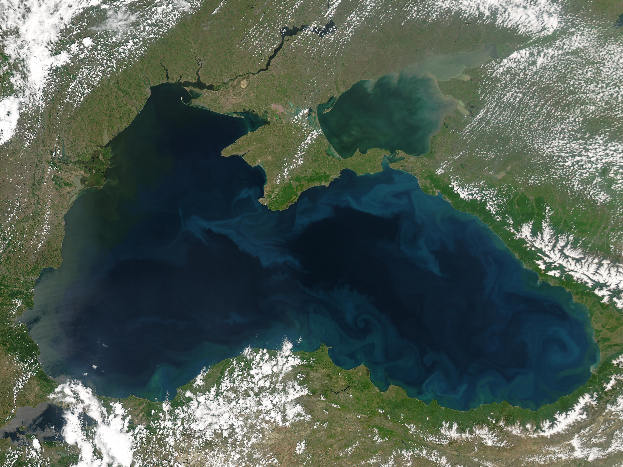
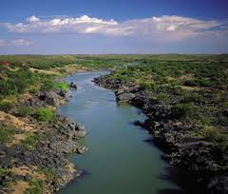
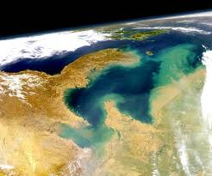
Black Sea TDA
Orange Senqu TDA
Yellow Sea TDA
Thematic report on fisheries
Socio-economic situation
Sustainable management of fisheries and aquaculture
Thematic report on biodiversity
Legal and institutional framework
Change of climate and evaluation of environmental vulnerability
Biodiversity protection
Thematic report on pollution loads
Thematic report on pollution assessment
Reductions on the stress of ecosystem, improvement of water quality and protection of human health
Biodiversity and ecosystems
Stakeholder analysis report
Deteriorating water quality as a result of pollution and land degradation
Causal Chain analysis report
Institutional development and capacity building
Governance analysis report
Hydrology of the Basin

Slide 15
Advice from the Field…..
Do not underestimate the time needed to develop thematic reports – It is likely that they will use up more time than is expected. The National experts will work at different speeds – some will complete the task in the allotted time. Others won’t.
Expertise – Ensure you have examined all possible avenues to identify national experts. Getting the right people is critical.
ToRs – Ensure the ToRs are well defined and fit for purpose. This will make the process easier to manage.

Slide 16
Section 8: TDA to SAP Linkage

Slide 17
In this Section you will learn about….
The TDA-SAP linkage
Leverage points
A process for identifying leverage points

Slide 18
TDA to SAP Linkage
Analysis

Slide 19
The Problem?
Often the TDA and the SAP are developed during 2 separate IW projects
This results in poor linkage between the ‘technical, non negotiated’ TDA and the ‘political, negotiated’ SAP
Failure to recognise that these 2 components part of the same strategic planning process, is likely to have a negative effect on the development and implementation of an effective and SAP

Slide 20
A Solution - Identifying Leverage Points
“A leverage point is a place within a complex system where a small shift at one point can produce large changes elsewhere”
Donella Meadows (1999)

Slide 21



The Identification of Leverage Points…
…is a critical linking step between the TDA and the SAP
From
Focusing on the analysis of problems
To
Pinpointing where changes can be made

Slide 22
A Note of Caution
This is not about trying to identify specific changes or solutions to be introduced – which is part of the strategic thinking process
This is about trying to pinpoint where changes can be made

Slide 23
Process for Identifying Leverage Points
Review the transboundary problems, impacts, causal chains and governance analysis
Identify where, in this map of cause-and-effect relationships, would interventions appear that have the largest potential for the broadest possible, positive influence on water system.

Slide 24
Group Exercise
In groups of five:
Review one of the transboundary problems, its impacts, causal chain
Where, would interventions appear to have the largest potential for the broadest possible, positive influence on water system?
Identify these leverage points – either graphically in the TDA materials and/or in list form
Timing: 20 minutes

