Slide 1

IW:LEARN
TDA/SAP Training Course
Module 3: Developing the SAP

Slide 2
Section 1: The Strategic Component – The SAP

Slide 3
In this Section you will learn about….
The strategic component – The SAP
Key steps of the SAP process
Key elements of the SAP process
The SAP development team

Slide 4
The TDA/SAP Process

Slide 5

SAP – The Strategic Component
The SAP is a negotiated policy document that should be endorsed at the highest level. It establishes clear priorities for action to resolve the priority problems identified in the TDA

Slide 6
The SAP has 3 key Steps
Strategic Thinking:
The collaborative development of the key components of the SAP - Vision, Goals Opportunities for Innovation; Options and Alternatives
Strategic Planning:
National and regional consultation processes; setting strategies for implementation; action planning; developing the draft action plan
Implementation:
Endorsing the SAP; key implementation steps

Slide 7
The SAP – Key Elements
A well-defined baseline enables a clear distinction between actions with purely national benefits and those addressing transboundary concerns with global benefits.
The development of institutional mechanisms at the regional and national levels for implementing the SAP
Monitoring and evaluation procedures to measure effectiveness of the outcomes of the process.

Slide 8
SAP Development Team….
The SAP Development Team is a broadly representative body of experts and stakeholders that will participate in the key development steps for the SAP
It should contain key members of the TDA Development Team to ensure continuity within the overall TDA/SAP process

Slide 9
Section 2: Strategic Thinking

Slide 10
In this Section you will learn about….
What is strategic thinking?
Why is it important
The strategic thinking process

Slide 11
What is Strategic Thinking?
Strategic Thinking is a highly collaborative process that focuses on finding and developing unique opportunities by enabling creative dialogue among people who can affect the direction of an organisation or system.
It is the input to strategic planning—good strategic thinking uncovers potential new ideas and opportunities, so that when the plan is created, it targets these opportunities.

Slide 12
Strategic Thinking
Set the Vision
Identify Goals
Brainstorm Ideas
Identify Options

Slide 13




SAP Strategic Thinking Steps
Defining the Vision
Setting
goals or status statements
Brainstorming innovative ideas
Identifying options or alternatives

Slide 14
Section 3: Defining a Vision and a Vision Statement

Slide 15
Where are we?
Defining the Vision
Setting
goals or status statements
Brainstorming innovative ideas
Identifying options or alternatives

Slide 16
In this Section you will learn about….
What is a vision?
A process for defining the vision
Examples of vision statements
Process for defining the vision

Slide 17
What is a Vision?
In the context of the TDA/SAP Approach, the vision is a long-term view describing the way the stakeholders think the water system should look in the future

Slide 18
A Long Term Vision Should Be….
Understandable
It should be understandable to the general public as well as a scientific audience
Inspirational
It should inspire those living in and around the water system to believe that they can improve the condition of their environment
Aspirational
It should encourage the relevant parties to strive to reach the vision
Ambitious
It must challenge those involved and really make a difference
Attainable
It must not be impossible - this can be very discouraging and is likely to result in failure

Slide 19

Black Sea SAP (2009)
"The vision for the Black Sea is to preserve its ecosystem as a valuable natural endowment of the region, whilst ensuring the protection of its marine and coastal living resources as a condition for sustainable development of the Black Sea coastal states, well-being, health and security of their population."

Slide 20
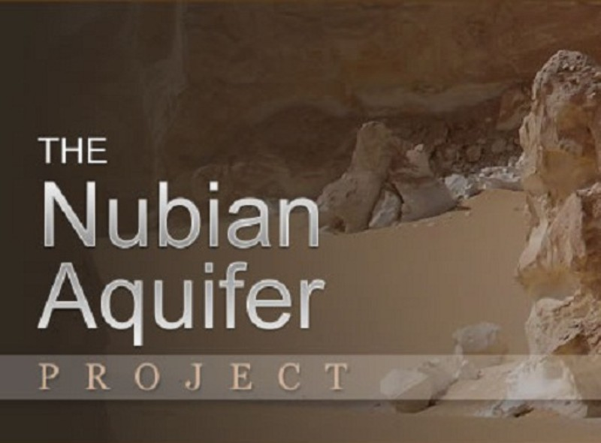
Nubian Aquifer SAP (2012)
"The vision for the NSAS adopted by the countries is: To assure rational and equitable management of the NSAS for sustainable socio-economic development and the protection of biodiversity and land resources whilst ensuring no detrimental effects on the shared aquifer countries."

Slide 21

Western Indian Ocean SAP (2009)
"People of the region prospering from a healthy Western Indian Ocean."

Slide 22

Mekong River Basin SAP (2006)
"An economically prosperous, socially just and environmentally sound Mekong River Basin."

Slide 23

Lake Victoria Basin SAP (2007)
"A prosperous population living in a healthy and sustainable managed environment providing equitable opportunities and benefits.”

Slide 24

Lake Chad SAP (2008)
"The Lake Chad Region would like to see by the year 2025 the Lake Chad common heritage and other wetlands maintained at sustainable levels to ensure the economic security of freshwater ecosystem resources, sustained biodiversity and aquatic resources of the basin, the use of which should be equitable to serve the needs of the population of the basin thereby reducing the poverty level."

Slide 25
Process for Defining the Vision
Step 2: Drafting of the vision statement based on the outputs from Step 1
Step 1: Development of a vision via a collaborative workshop

Slide 26
Step 1: Development of a vision via a collaborative workshop
This step can successfully be accomplished through a collaborative workshop involving the SAP Development team and supplemented with additional specialists
The workshop can be run during the same meeting that the Goals are identified

Slide 27
Step 2: Drafting the vision statement
It is highly probably that the outputs from the visioning workshop will only provide a starting point for the Vision Statement
The SAP Development Team (or selected members of the team) will need to take the group vision statements and combine them into a single statement

Slide 28
Group Exercise
In groups of 5:
  What are your best hopes for the water system in 20 years?
Timing: 20 minutes

