Slide 1
IW:LEARN TDA/SAP Training Course
Module 3: Developing the SAP

Slide 2
Section 4: Defining Goals

Slide 3
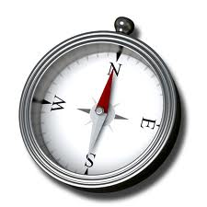
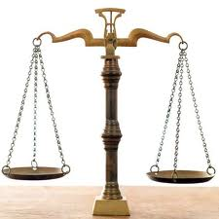
Where are we?
Defining the Vision
Setting goals or status statements
Brainstorming innovative ideas
Identifying options or alternatives

Slide 4
In this Section you will learn about….
What is a Goal and What is an Objective?
Goals Vs. Ecosystem Quality Objectives
Process for Defining Goals

Slide 5
What are Goals and Objectives?
Goals…
…are general guidelines that explain what you want to achieve in your water system - they are usually long-term and represent global visions such as “reduce pollution by…..” or “increase biodiversity by…..”.
Objectives…
…define strategies or implementation steps to attain the identified goals. Unlike goals, objectives are specific, measurable, and have a defined completion date.
Actions…
…Often, each objective is associated with a series of actions. Therefore, implementing a strategic goal typically involves implementing a series of actions along the way.

Slide 6
And in the context of the SAP?
In terms of the SAP, the Goals are long-term targets to achieve the vision and reduce the impact of each transboundary problem.
Conversely, the Objectives are strategies or implementation steps to achieve the goals.

Slide 7
Goals Vs. Ecosystem Quality Objectives
Goals and Objectives
Classic strategic planning approach
Generally comprises of longer term goals or targets followed by shorter term objectives or activities
More often, although not exclusively, used by LME projects
Examples include: Guinea Current LME, Mediterranean LME, South China Sea LME, Mekong River Basin

Slide 8
Goals Vs. Ecosystem Quality Objectives
Ecosystem Quality Objectives (EcoQOs)
Sometimes referred to as Environmental Quality Objectives (EQOs) or Water Resource Objectives (WROs)
Comprise of long-term EcoQO’s followed by shorter-term targets
Generally used by projects focused on enclosed seas, fresh water and groundwater systems
Examples include: Caspian Sea, Dnipro River Basin, Black Sea, Lake Victoria, Lake Chad, Western Indian Ocean, Nubian Aquifer

Slide 9
Process for Defining Goals
Step 2: Further development of the goals based on the outputs from Step 1
Step 1: Identification of Goals via a collaborative workshop

Slide 10
Step 1: Identification of goals via a collaborative workshop
This step can also be successfully be accomplished through a collaborative workshop involving the SAP Development team and supplemented with additional specialists
The workshop can be run during the same meeting that the Vision is identified

Slide 11
Goal Identification
Prior to the workshop, the Project Manager and key SAP Development Team members will need to draft a list of provisional goals together with approximate timeframes, including information on which priority transboundary problem(s) to which they are linked.

Slide 12
Step 2: Further development of the goals
It is highly probable that the outputs from this workshop will only provide a starting point for the development of more finalised goals.
At the very most, it will produce a comprehensive list of potential draft goals, linked to transboundary problems (and possibly the causal chain analysis and governance analysis), with approximate time frames.

Slide 13
Goal Development
The purpose of this step is to finalise the goals
This is best accomplished after the workshops on:
Brainstorming new ideas and opportunities to meet the goals
Identifying options or alternatives
As all 3 steps are closely linked

Slide 14
Group Exercise
In groups of 5:
Identify a number of goals (or EcoQOs) based on the vision and the outputs of the TDA process (transboundary problems and leverage points)
Timing: 20 minutes

