Slide 1

IW:LEARN
TDA/SAP Training Course
Module 2: Development of the TDA

Slide 2
Section 4: Transboundary Problem Identification and Prioritisation

Slide 3
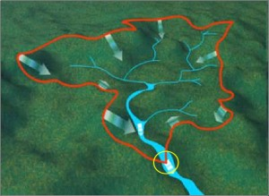

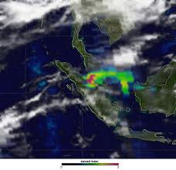

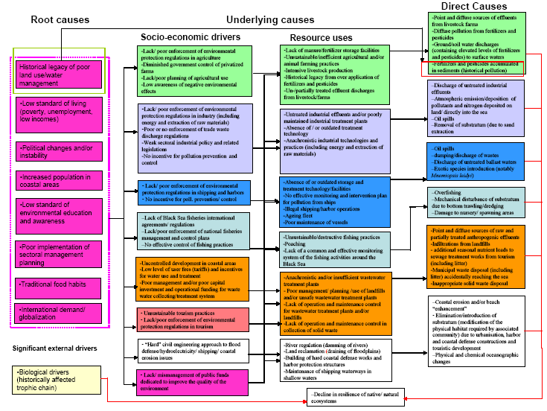

Where are we?
Defining system boundaries
Collection
and analysis of data/information
Identification
&
prioritisation
of the transboundary problems
Determination of the
impacts of each priority problem
Analysis
of the immediate, underlying, and root causes for each problem
Development of thematic reports

Slide 4
In this Section you will learn about….
What are transboundary problems
What are shared environmental problems
Climate Change - Is it an International Waters Transboundary Problem?
A process for identifying and prioritising transboundary problems

Slide 5
What is a Transboundary Problem?
A transboundary problem is an environmental problem that is transboundary in scale.
In other words, it is an environmental problem originating in, or contributed by, one country and affecting (or impacting) another.

Slide 6
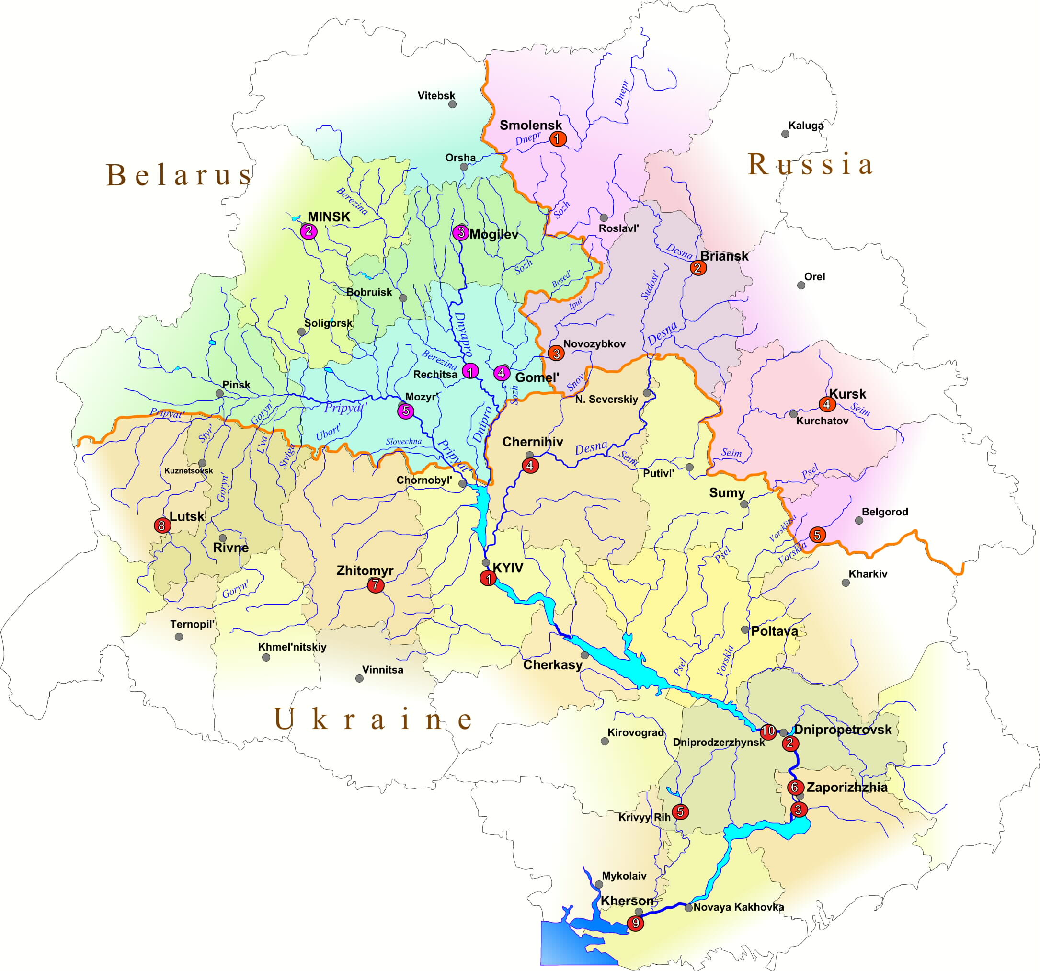
Nutrients emitted (point and diffuse)
Impacts felt
Example of a Transboundary Problem:
Dnieper River Basin

Slide 7
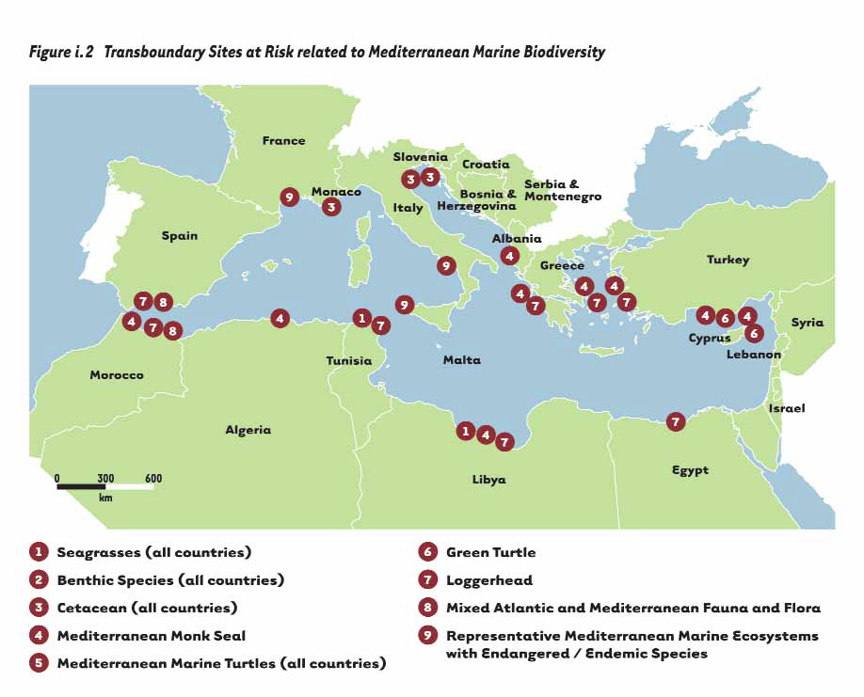
Loss of Habitats (Loggerhead Turtle nesting sites)
Loggerhead Turtle Migration
Example of a Transboundary Problem:
Mediterranean Sea

Slide 8
What is a Shared Environmental Problem?
A shared environmental problem is an environmental problem that is shared between 2 or more countries in a given water system
The problem is not transboundary as given in the definition above but is a common problem in the region

Slide 9
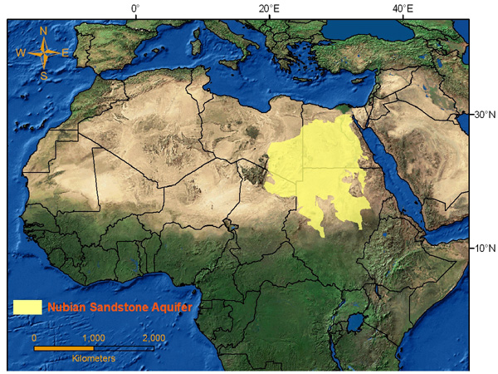
Declining Water levels
Example of a
Shared
Problem:
Nubian Sandstone Aquifer

Slide 10
Further
examples:
Marine

Slide 11
Further
examples:
River Basins

Slide 12
Further
examples:
Lakes

Slide 13
Further
examples:
Aquifers

Slide 14
Climate Change - Is it an International Waters Transboundary Problem?
Climate change has been seen as beyond the scope of IW project intervention and consequently any single TDA/SAP process
But climate change is an external driver of many of the above problems – something that cannot be changed in the short to medium term (although its impacts can be mitigated against or adapted to)

Slide 15
Climate Change - Is it an International Waters Transboundary Problem?
Many transboundary problems are reinforced (both positively or negatively) by climate change.
Whether climate change is considered as a transboundary problem or not, its effects (in terms of cause and impact) need to be well understood to ensure that future interventions are both resilient and adaptive

Slide 16
Identifying and Prioritising Transboundary Problems
Crucial part of the TDA/SAP process and the TDA development phase
Transboundary Problems not identified at this stage may not be captured at a later stage

Slide 17
Prioritisation- an Integral part of Strategic Planning
A key to TDA development and the ultimate success of the TDA/SAP process is the importance of prioritisation
Because there are often limited available resources, prioritisation helps to identify which transboundary problems need to be considered further in the TDA
Prioritisation usually requires a set of criteria

Slide 18
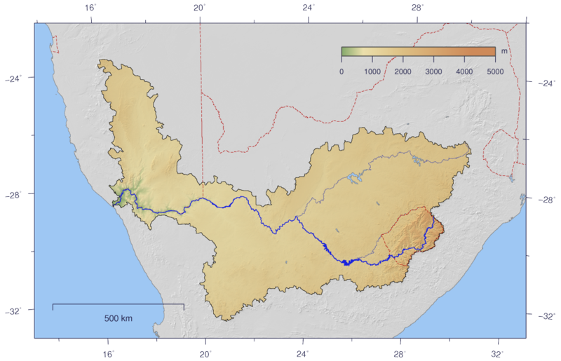
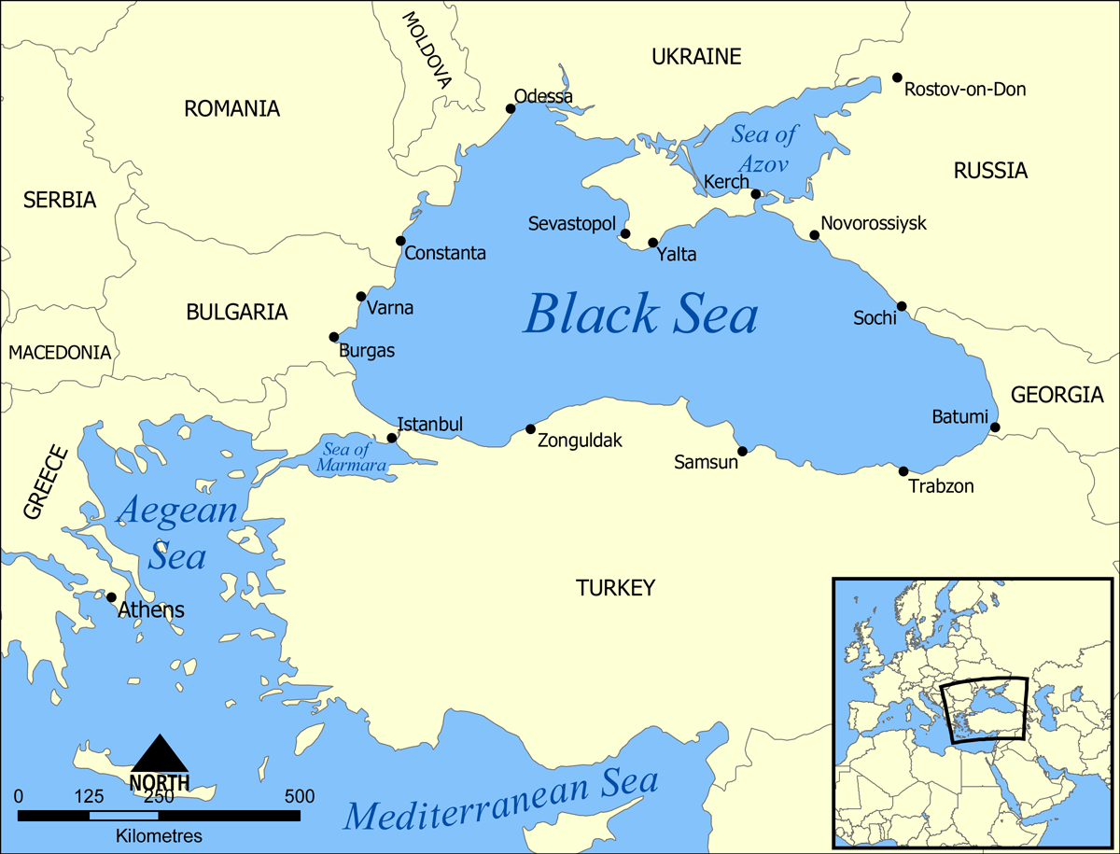
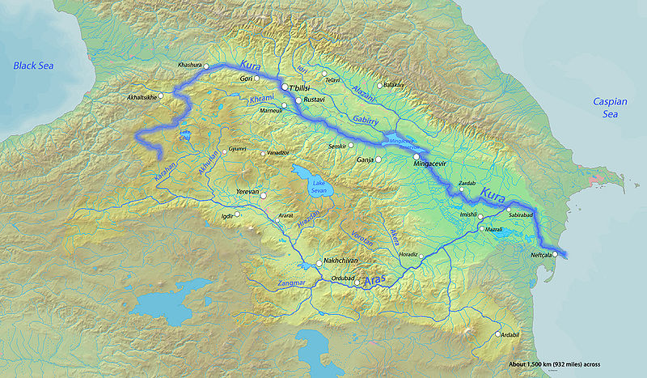
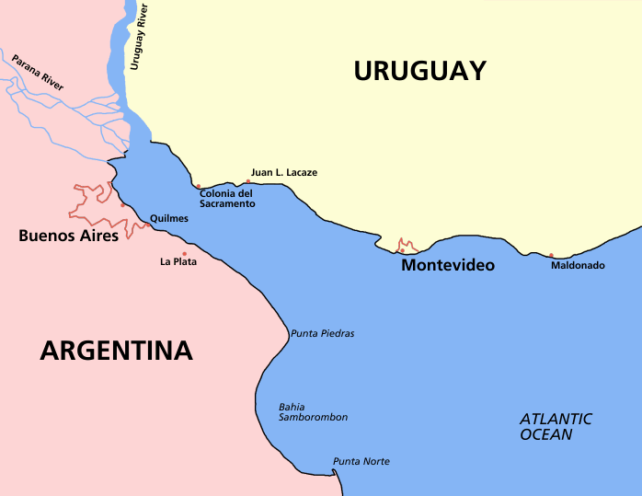
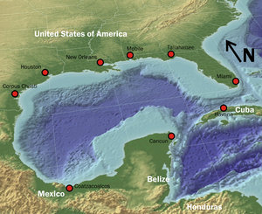
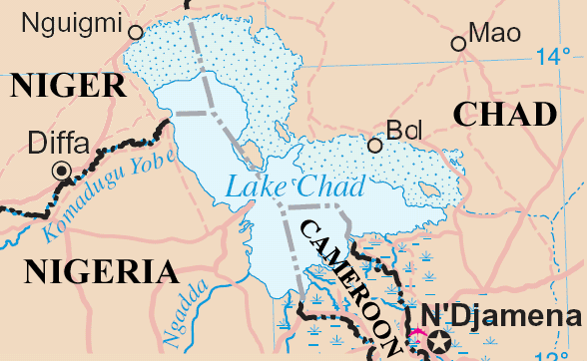
Orange-Senqu
River Basin
Black Sea
Kura – Aras River Basin
Dnieper River Basin
Projects that have used this approach:
Nubian Aquifer
Gulf of Mexico
Lake Chad
Rio de la Plata

Slide 19
Collaborative Process
Approach: Collaborative workshop with the full TDA Development Team
Purpose:
To reach a consensus on the priority transboundary problems affecting the water system.
The Task:
To brainstorm a complete list of the transboundary problems for the water system

Slide 20
Group Exercise
In whole group:
Brainstorm a complete list of the transboundary problems for the water system
Identify the real transboundary environmental problems
Identify the geographical scale of each problem and how strongly transboundary the problems are
Individual team members to prioritise the problems based on a set of criteria
Timing: 30 minutes

Slide 21
Brainstorming Guidelines
Avoid linking names to ideas
Encourage all ideas - anything is possible
Defer judgment
Encourage each other
Go for quantity - accept everything!
Build on each others ideas

Slide 22
Group Exercise
In whole group:
Brainstorm a complete list of the transboundary problems for the water system
Identify the real transboundary environmental problems
Identify the geographical scale of each problem and how strongly transboundary the problems are
Individual team members to prioritise the problems based on a set of criteria
Timing: 30 minutes

