Slide 1

IW:LEARN
TDA/SAP Training Course
Module 2: Development of the TDA

Slide 2
Section 5: Determination of Impacts

Slide 3
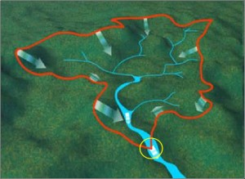

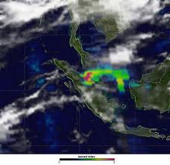

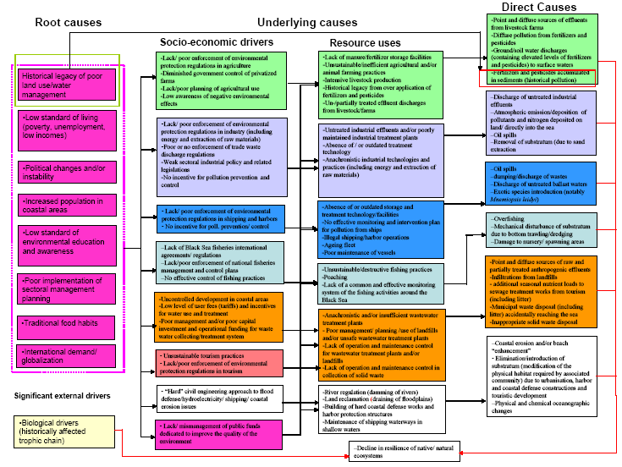

Where are we?
Defining system boundaries
Collection
and analysis of data/information
Identification
&
prioritisation
of the transboundary problems
Determination of the
impacts of each priority problem
Analysis
of the immediate, underlying, and root causes for each problem
Development of thematic reports

Slide 4
In this Section you will learn about….
What are environmental impacts in relation to the TDA?
What are socio-economic impacts in relation to the TDA?
A process for determining environmental and socio-economic impacts
Notes:
----- Meeting Notes (24/08/2012 11:58) -----

Slide 5
In the Context of the TDA/SAP process….
ENVIRONMENTAL IMPACTS
Are the effects of a transboundary problem on the integrity of an ecosystem
SOCIO-ECONOMIC IMPACTS
Are a change in the welfare of people attributable to the transboundary problem or its environmental impacts.

Slide 6
For Example
INDIRECT
ENVIRONMENTAL IMPACT Reduced fish population
SOCIO-ECONOMIC IMPACT
Loss of income
Loss of food source
TRANSBOUNDARY PROBLEM Eutrophication
SOCIO-ECONOMIC IMPACT
Health impacts from drinking water
DIRECT

Slide 7
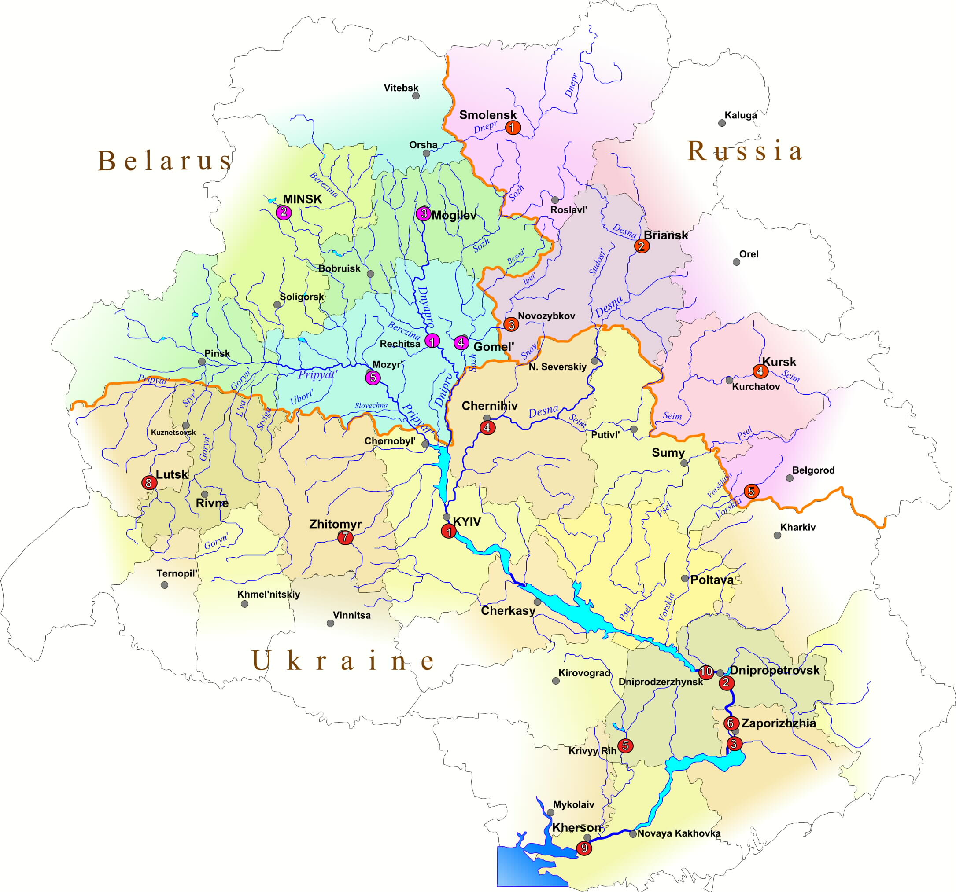
Nutrients emitted (point and diffuse)
Impacts felt
Example of a Transboundary Problem and Impacts:
Dnieper River Basin

Slide 8
Black Sea Dead Zone
Evolution of the NW Shelf ‘Dead Zone’
Decline in the Phyllophora beds on the NW Shelf

Slide 9
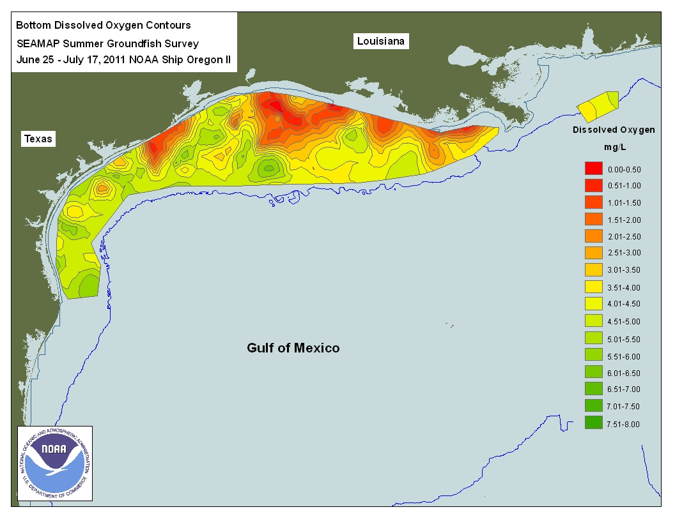

Slide 10
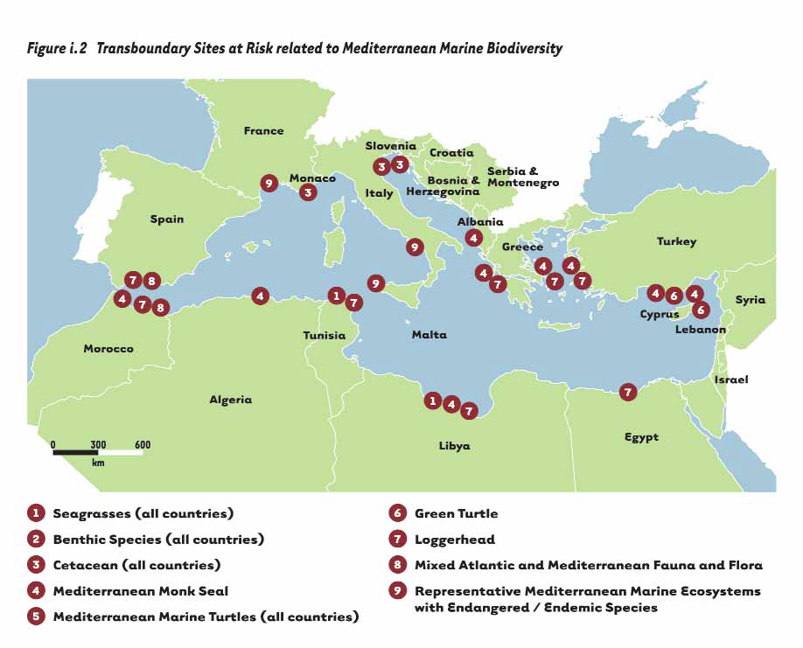
Loss of Habitats (Loggerhead Turtle nesting sites)
Loggerhead Turtle Migration
Example of a Transboundary Problem and impacts:
Mediterranean Sea

Slide 11
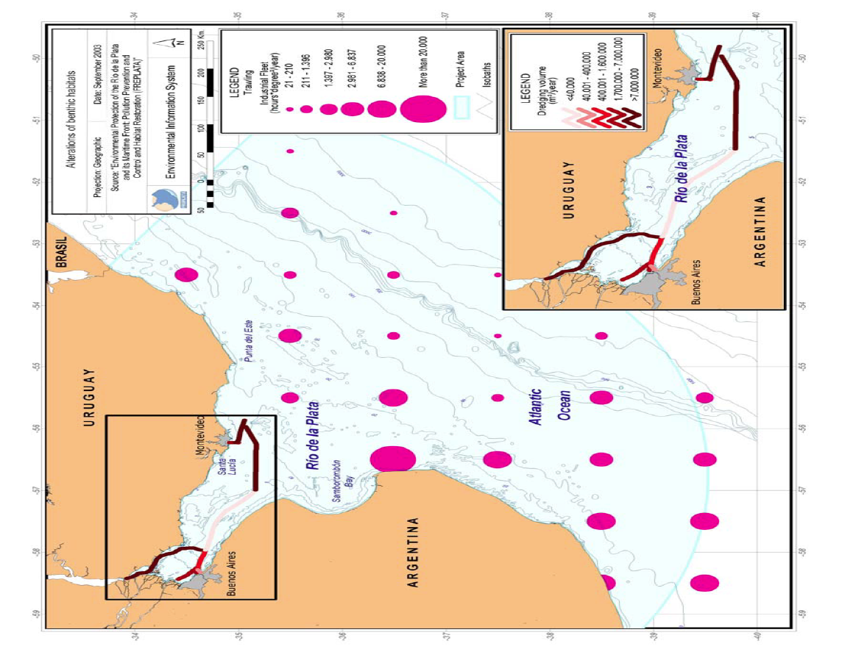
Indicators of alterations of benthic habitats (Source: FREPLATA, 2005)

Slide 12
Process for determining impacts
Step 2: Qualitative or quantitative description of key environmental and socio-economic impacts
Step 1: Identification of the environmental and socio-economic impacts of each priority transboundary problem

Slide 13
Step 1: Identification of the impacts of each priority transboundary problem
This step can successfully be accomplished through a collaborative workshop involving the TDA Development team
The workshop can be run during the same meeting that the transboundary problems are identified and prioritised

Slide 14
Step 2: Description of key environmental and socio-economic impacts
The purpose of this step is to describe the problem itself (using available survey data showing changes over time, etc.) and the impact of the problem on the environment and socio-economically

Slide 15
Possible Options
Use of simple lists
  of the identified impacts, based on the output from step 1. (e.g. Dnipro River Basin TDA)
Detailed supporting text for the impacts
  including maps, graphics and figures (e.g. Rio de la Plata; Orange Senqu River Basin TDA)
The development of a set of relevant indicators
  for which data is available, including baseline data, showing changes over time

Slide 16
Analysis of Impacts
All these options are valid and will depend on the level of data and information available
However, in all cases, the information gathered should concentrate on the transboundary impacts although national or localised impacts can also be described if they are relevant

Slide 17
Group Exercise
In groups of five:
Take one of the priority transboundary problems and identify:
  The environmental impacts
  The direct and indirect socio-economic consequences
  Identify geographical location(s) of impacts/consequences
Timing: 20 minutes

Slide 18
Brainstorming Guidelines
Avoid linking names to ideas
Encourage all ideas - anything is possible
Defer judgment
Encourage each other
Go for quantity - accept everything!
Build on each others ideas

Slide 19
Group Exercise
In groups of five:
Take one of the priority transboundary problems and identify:
  The environmental impacts
  The direct and indirect socio-economic consequences
  Identify geographical location(s) of impacts/consequences
Timing: 20 minutes

