Slide 1

IW:LEARN
TDA/SAP Training Course
Module 2: Development of the TDA

Slide 2
Section 6: Causal Chain Analysis

Slide 3
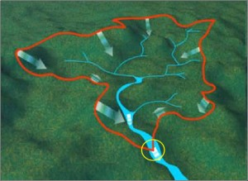

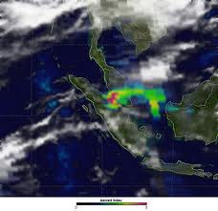
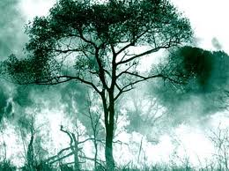
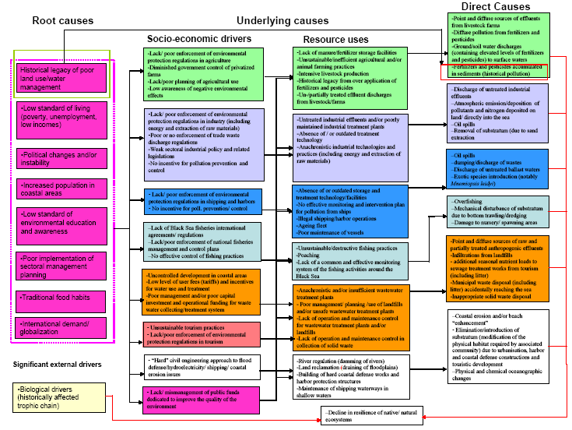

Where are we?
Defining system boundaries
Collection
and analysis of data/information
Identification
&
prioritisation
of the transboundary problems
Determination of the
impacts of each priority problem
Analysis
of the immediate, underlying, and root causes for each problem
Development of thematic reports

Slide 4
In this Section you will learn about….
What is a causal chain analysis
The key components of a causal chain
How to develop a causal chain
Advice from the field

Slide 5
What is Causal Chain Analysis?
Causal Chain Analysis (CCA) is closely related to systems thinking
Systems thinking focuses on the dynamic and complex whole system interacting as a structured functional unit
CCA approaches are generally linear, examining cause and effect

Slide 6
What is Causal Chain Analysis?
At its most basic, a causal chain is an ordered sequence of events linking the causes of a problem with its effects. Each link in the causal chain is created by repeatedly answering the question ‘Why?’

Slide 7
For Example

Slide 8
Strength of Causal Chain Analysis
Problems are best solved by attempting to address, correct or eliminate root causes as opposed to merely addressing the immediately obvious symptoms

Slide 9
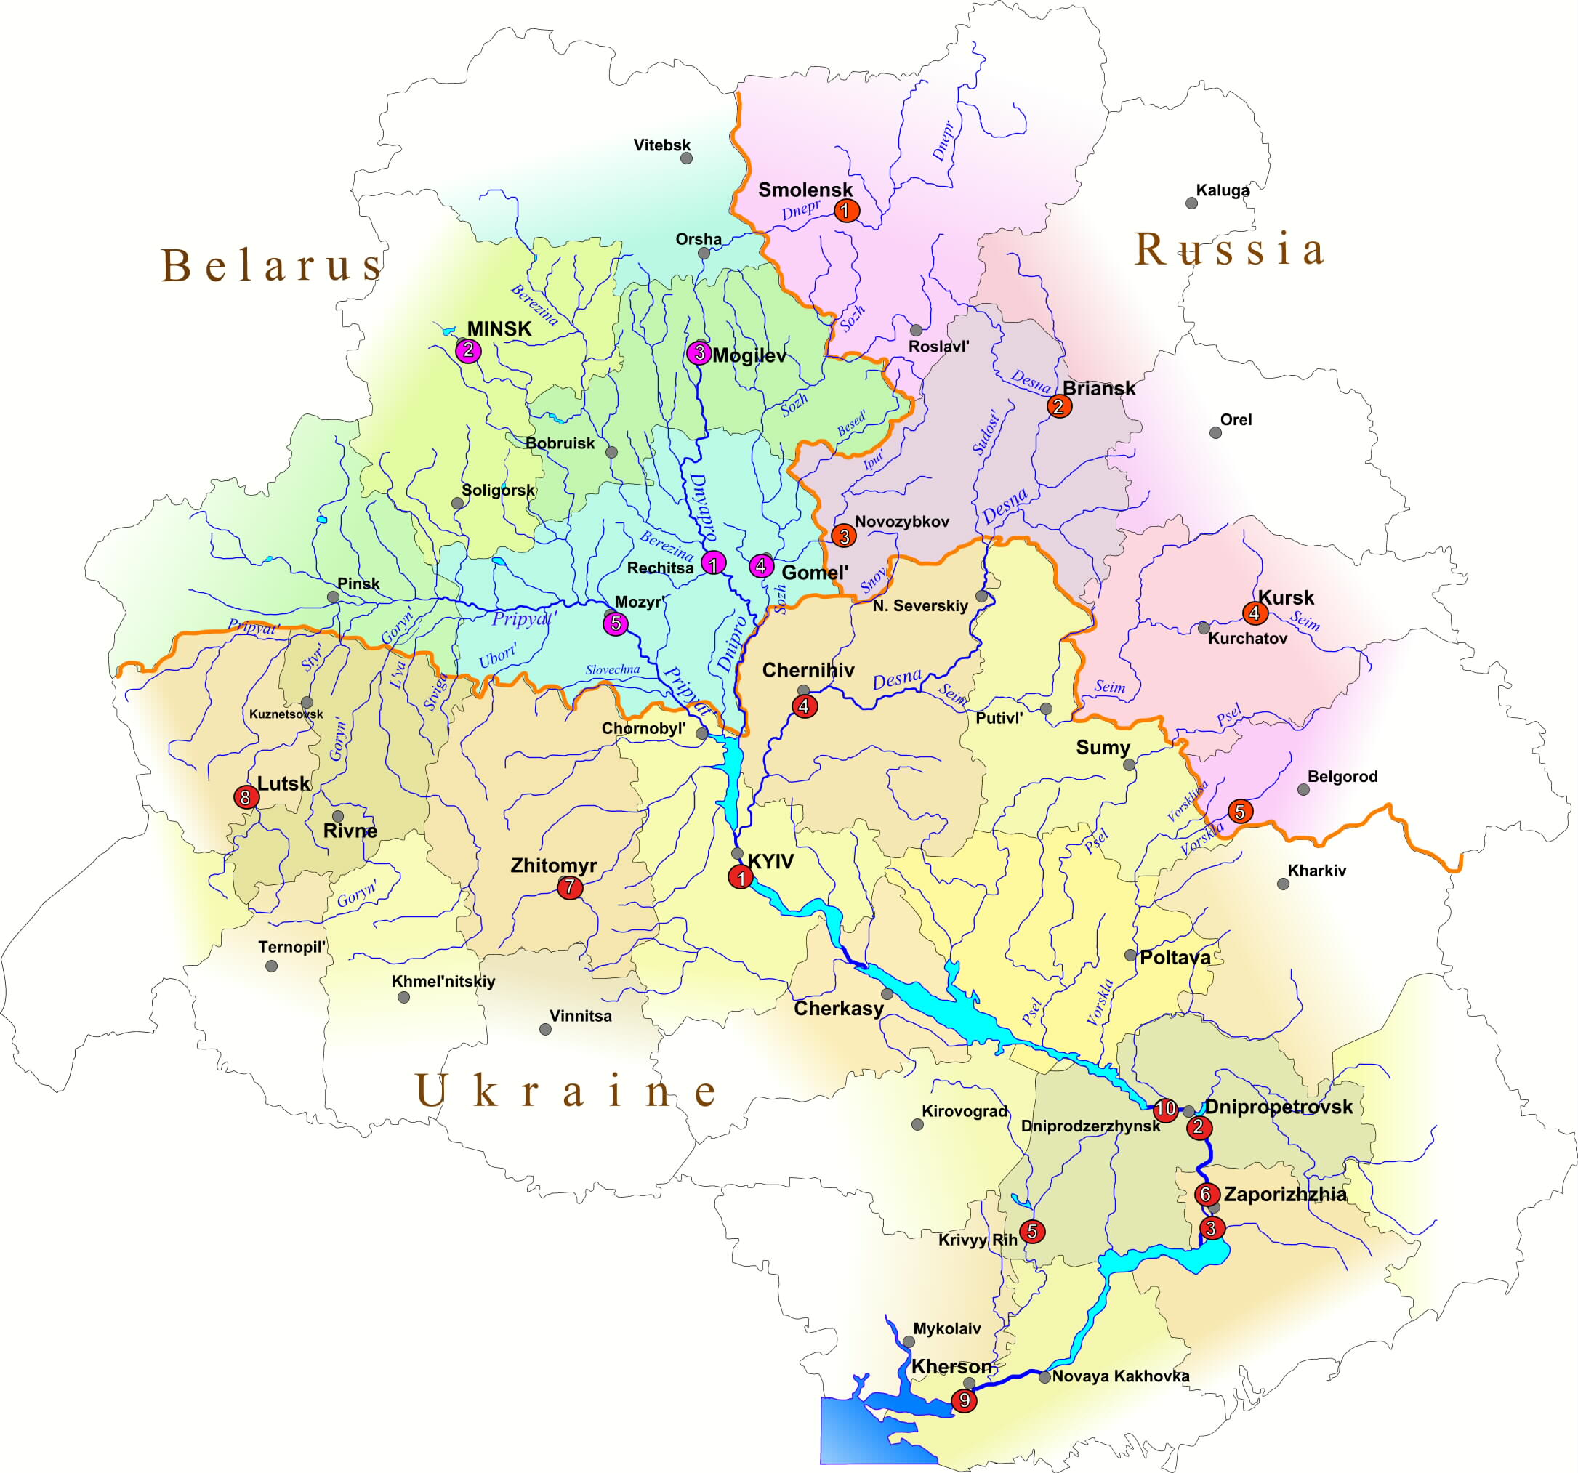
Cause: Diffuse sources of nutrients from agriculture
Impact: Loss of fish population
Dnieper River Basin
Transboundary Problem: Eutrophication

Slide 10
Black Sea Dead Zone
Evolution of the NW Shelf ‘Dead Zone’
Decline in the Phyllophora beds on the NW Shelf

Slide 11
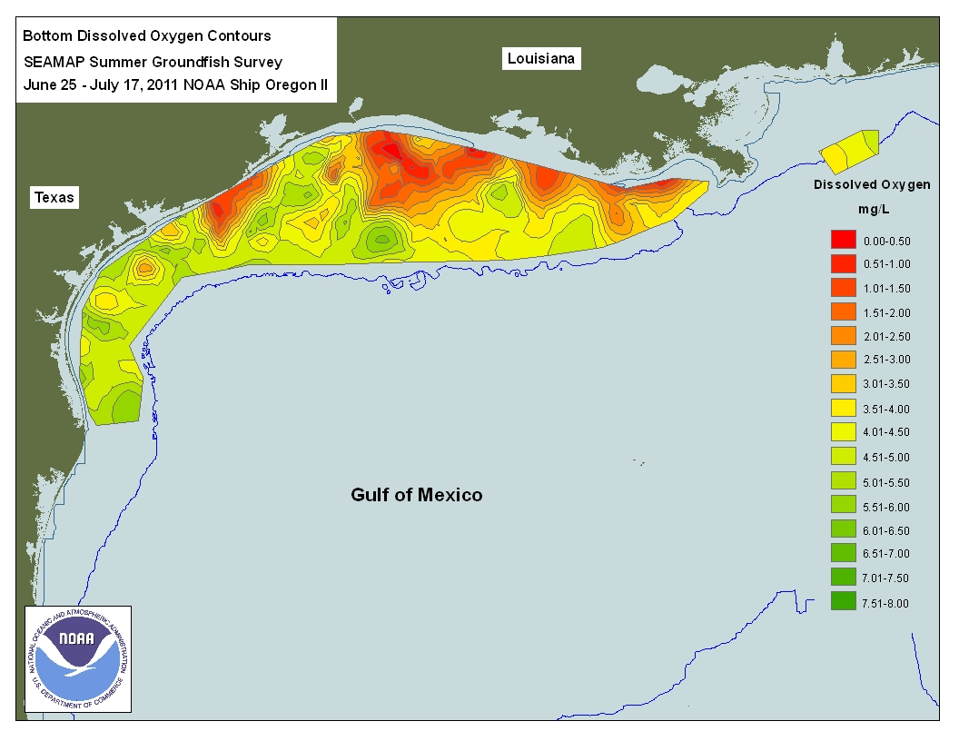

Slide 12
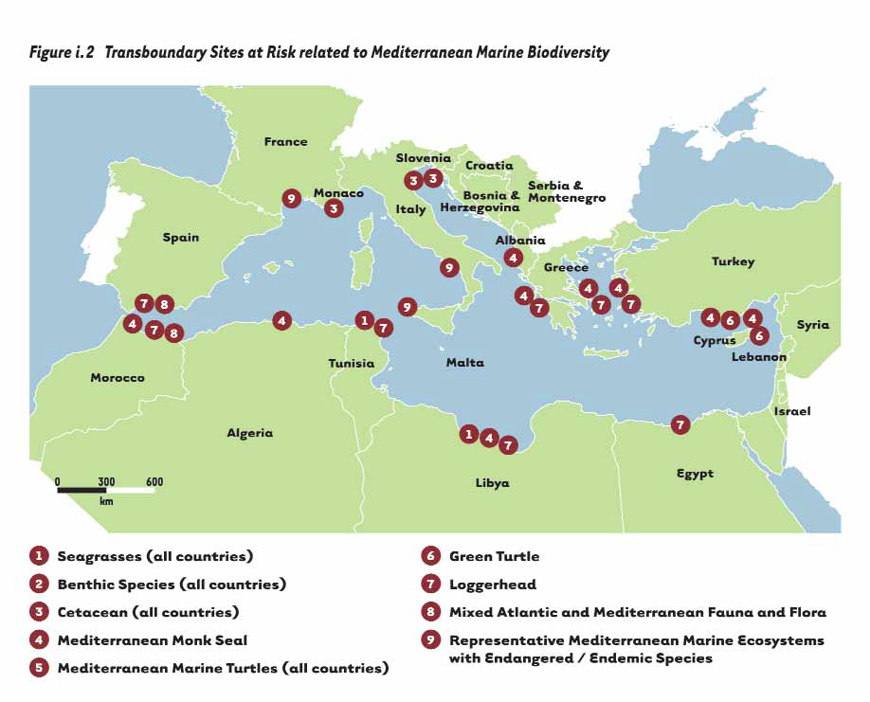
Impact: Reduction in Loggerhead Turtle nesting sites
Loggerhead Turtle Migration
Cause: Urbanisation; Tourism
Mediterranean Sea
Transboundary Problem:
Loss of Habitat

Slide 13
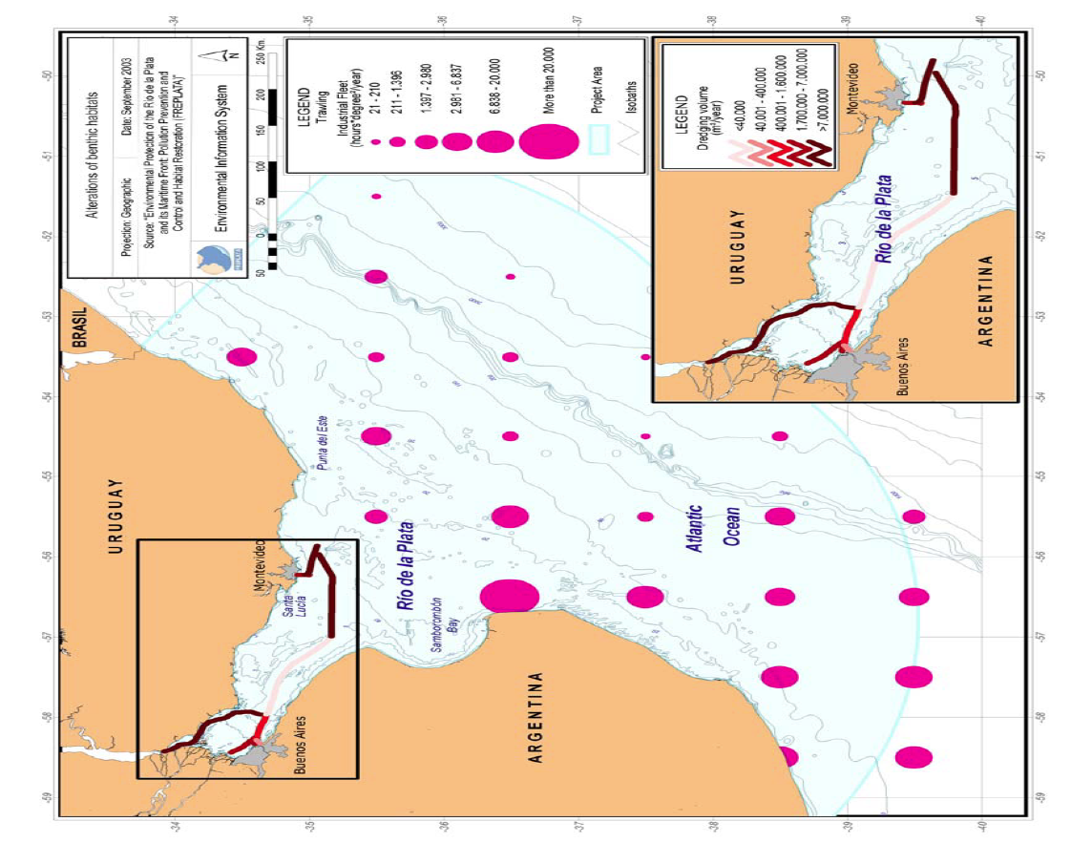
Indicators of alterations of benthic habitats (Source: FREPLATA, 2005)

Slide 14
Causal Chain as a component of a Policy Response System
IMMEDIATE CAUSES
UNDERLYING CAUSES
IMPACTS
Driver
Response
ROOT CAUSES
POLICY RESPONSE

Slide 15
Components of a Causal Chain
A causal chain is an ordered sequence of events linking the causes of a problem with its effects
Immediate or technical causes
Underlying causes
Root causes

Slide 16
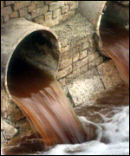
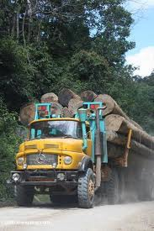
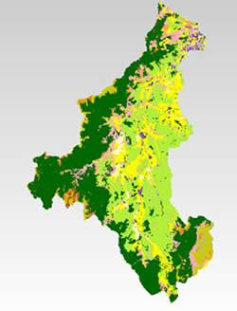
Immediate Causes…
…are usually the direct technical causes of the problem
They are predominantly tangible (e.g. enhanced nutrient inputs), and with distinct areas of impact
Being technical in nature they are the most straightforward to quantify, prioritise and geographically locate using maps.

Slide 17
Examples of Immediate Causes

Slide 18
Underlying Causes…
…..are those that contribute to the immediate causes. They can broadly be defined as:
Underlying resource uses and practices
Social and economic causes

Slide 19
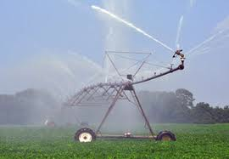
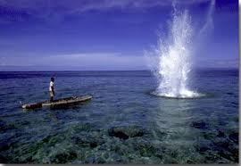
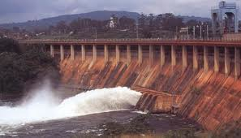
Resource uses and practices
Land uses (reclamation/drainage operations, deforestation, agriculture)
Damaging or unsustainable practices (Intensive livestock production, lack of or outdated water treatment technology, destructive fisheries practices)
Uses of water (diversion, storage etc)

Slide 20
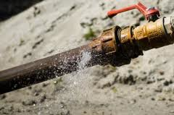
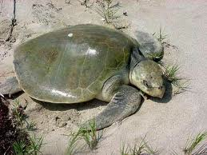
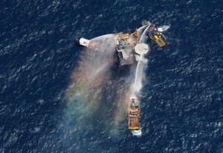
Social and Economic Causes
Lack of investment, operation and maintenance
Poor awareness or education
Governance failures – legislation, regulation, enforcement

Slide 21
Root Causes
Root causes are linked to the underlying social and economic causes and sectoral pressures
However, they are often related to fundamental aspects of macro-economy, demography, consumption patterns, environmental values, and access to information and democratic processes

Slide 22
Root Causes
Many root causes may be beyond the scope of GEF intervention but it is important to document them for two reasons:
  Some proposed solutions might be unworkable if the root causes of the problem are overwhelming
  Actions taken nearer to the root causes are more likely to have a lasting impact on the problem

Slide 24
Ease of Assessment
Immediate or technical causes
Underlying causes
Root causes
Technical in nature: Straightforward to quantify, prioritise and geographically locate using maps
Generally more difficult: Information on socio-economic causes will often be at a national and not basin level
Most difficult: Information available will be be national and may be difficult to disaggregate
Easy
Difficult

Slide 25
Boundaries Between Causes
The 3 categories of causes described above (immediate, underlying, root) are not necessarily discrete from each other
Immediate causes can often be very close to underlying causes, particularly resource uses and practices.
underlying social and economic causes are often very close to the root cause of the problem
The key point to remember is that for the purpose of the TDA, there is likely to be some form of separation of causes to allow for a rigorous analysis, but in reality, causes are often more complicated….

Slide 26
How to Develop a Causal Chain
A causal chain should be developed for each priority transboundary problem
The process of undertaking CCA is not prescriptive
A number of different approaches to CCA have been developed, some more successfully than others

Slide 27
Stepwise Process
Used by a number of projects, including:
The Black Sea
Gulf of Mexico LME
Kura-Aras River Basin
Dnipro River Basin
Lake Chad
Orange-Sengu River Basin
Nubian Aquifer

Slide 28
Process for Developing Causal Chains
Step 2:
Further development of the causal chains based on the outputs from Step 1
Step 1:
Identification of the components of the causal chain for each priority transboundary problem

Slide 29
Step 1: Identification of the components of the causal chain
As with the previous workshops
-Identification of Priority Transboundary Problems and Analysis of Impacts - this step can successfully be accomplished through a collaborative workshop involving the TDA Development team

Slide 30
Step 2: Further development of the causal chains
Outputs from the CCA workshop will only provide a starting point for the completed causal chains
At the very most, it will produce a comprehensive list of sectors, immediate, underlying and root causes for the priority transboundary problems with information on linkages between different levels

Slide 31
Step 2: Further development of the causal chains
The purpose of this step is to complete each causal chain and provide quantitative or qualitative data to substantiate the analysis if possible
Two approaches for undertaking this step are:
      Tables or matrices
      Flow diagrams

Slide 32
Examples of Causal Chains

Slide 33
Dnipro Basin Causal Chain – Ca. 2003
Institutional/Legal causes
Socio-economic causes
Economic
Policy
Legislation
Governance
Social
Location and concentration of industrial complexes
Ineffective national/regional policies/management plans
Deficiencies in institutional capacity
Deficiencies in legislation
Increased role of mining for export income
ENERGY
URBANISATION
TRANSPORT
FISHERY/
AQUACULTURE
AGRICULTURE
Limited capital Investment
Lack of incentives
Inadequate economic instruments/tariffs
Deficiencies in implementation of regulations, monitoring and enforcement
Deficiencies in institutional capacity
Ineffective national/regional policies/management plans
Deficiencies in institutional capacity
Deficiencies in legislation
Deficiencies in institutional capacity
Deficiencies in legislation
Limited capital
Investment
Ineffective national/regional policies/management plans
Ineffective national/regional policies/management plans
Deficiencies in legislation
Lack of human/ technical capacity
Lack of adequate finance
Deposition of pollution from transport
Deficiencies in implementation of regulations, monitoring and enforcement
Lack of incentives (subsidies)
Inadequate economic sanctions (taxes)
Deficiencies in implementation of regulations, monitoring and enforcement
Limited capital Investment
Sewage pricing
Limited ability of users to pay
Deficiencies in implementation of regulations, monitoring and enforcement
Inadequate tariffs
Lack of incentives
Lack of capacity
Exploitation of new mineral deposits
Inadequate or lacking water/waste management systems
Budget/ expenditure for operation and maintenance
Limited capital Investment in industry
Power generation
Construction/poor design of reservoir chain
Lack of planning
Lack of human/ technical capacity
Lack of adequate finance
Lack of land tenure
Lack of human/technical capacity
Lack of adequate finance
Failures in operation and maintenance
Lack of implementation of sustainable practices
Demand for cheap food
Growth in industry
Inadequate technology
Inadequate implementation of clean technologies
Lack of alternative industrial processes
Discharges of cooling waters*
*Enhances impacts of eutrophication. Cooling waters are not a cause of eutrophication
See industry sector
Lack of storage facilities for liquid and solid wastes
Lack of cultivation margins
Over application/ incorrect use of fertilisers in agriculture
Over ploughing
Concentration of agro-industrial facilities
Intensive livestock production
Failures in operation and maintenance
Inadequate technology/ poor infrastructure
Poor pond siting in river channels/
catchments
Poorly or untreated return waters
Inefficient old technologies and inherently polluting processes
Inadequate waste treatment technology
Failures in operation and maintenance
Design and location of waste disposal sites
Poorly or untreated sewage waste
No sewage collection
Poor waste disposal practices from small businesses
Pollution by return waters from fish ponds
Erosion of soils
Inefficient practices
Inadequate waste management
Operational discharge of liquid and gaseous effluents including cooling waters
Growth in production of waste
Operational discharge of liquid and gaseous effluents including cooling waters
Emissions from storage or disposal of solid wastes
Emissions from storage or disposal of liquid wastes
Runoff
Point sources of pollution
Extensive area of shallow water sections in the reservoir chain
Diffuse sources of pollution
8. EUTROPHICATION
Deterioration of water
quality due to intensive algal blooms
Changes in redox capacity
Changes in structure and
functions of aquatic ecosystems
Changes in species composition and productivity of native fish

Slide 34
Dnipro Basin Causal Chains
Highly detailed and complex
Required a great deal of time and expertise to complete
Difficult to analyse and difficult for a decision maker to translate into action

Slide 35
Caspian Sea Causal Chain – Ca. 2001
DAMAGE TO SHORE ZONE INFRASTRUCTURE
INSUFFICIENT AREA RESOURCES
INADEQUATE USE OF COASTAL AREA
Narrow coastal zones as marine alluvial strips
Narrow coastal zones on Eastern side due to bordering to deserts
Historical development of coastal areas
Non-existent integrated coastal area management
Natural conditions
(geomorphology, climate, flooding)
  Non-existent knowledge about water fluctuations
Weak economic situation
Increase of population
Inadequate enforcement of existing regulatory instruments
Inadequate legislation
Insufficient regional planning (legislation, planning procedures, funding, investments)

Slide 36
Caspian Sea Causal Chains
Very little detail
Perceived lack of understanding of CCA methodology
Lack of logic
Difficult for a decision maker to translate into action

Slide 37
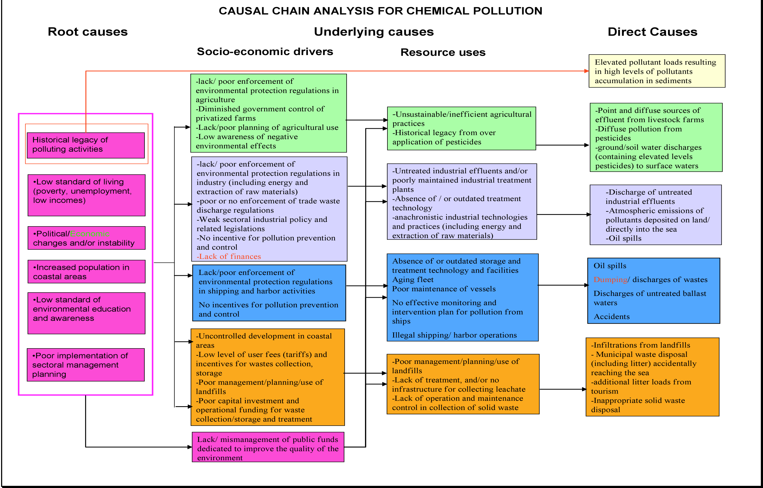
Black Sea Causal Chain – Ca. 2007

Slide 38
Black Sea Causal Chains
Some linkage and logical process
Could still have more detail
Easier for a decision maker to translate into action
BUT is it the right action? Does it have enough detail?

Slide 39
Kura-Aras River Basin Causal Chain – Ca. 2006

Slide 40
Kura-Aras River Basin Causal Chains
Good level of detail
Some linkage and logical
Links causes to impacts – a good idea
Easy for a decision maker to translate into action

Slide 41
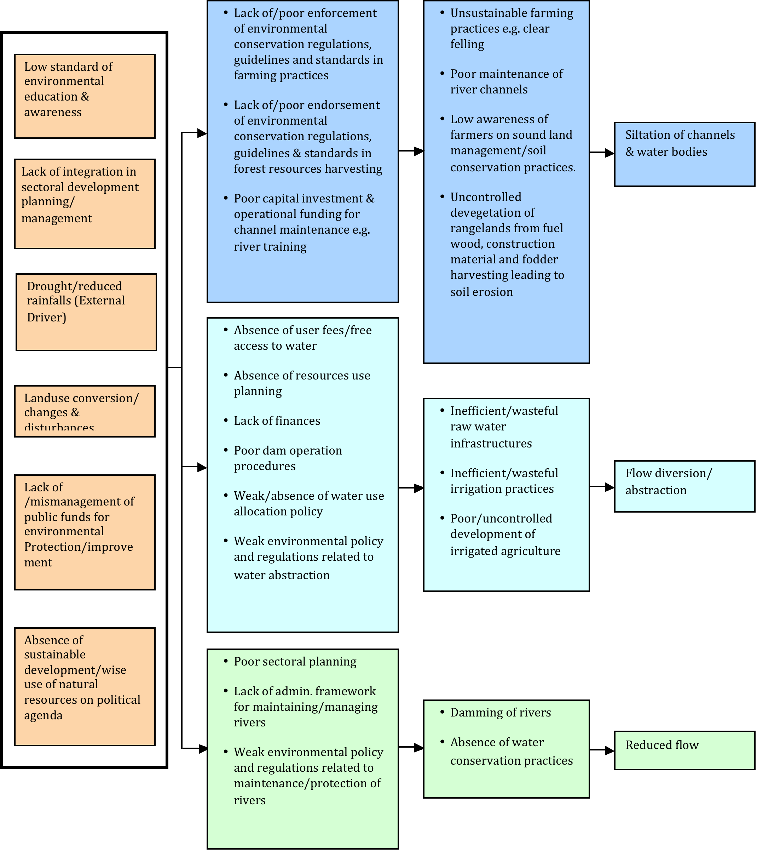
Lake Chad Causal Chain
Ca. 2007

Slide 42
Lake Chad Causal Chains
Reasonable level of detail
Not much linkage but logical
BUT Could a decision maker translate into action?

Slide 43
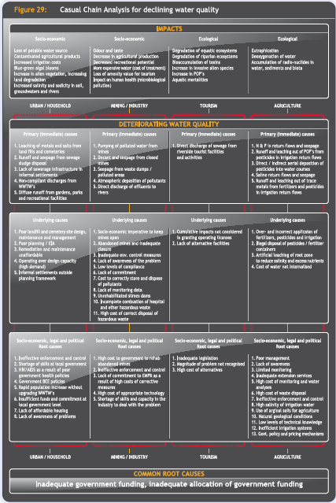
Orange-Senqu River Basin Causal Chain
Ca. 2008

Slide 44
Orange Senqu River Basin Causal Chains
Good level of detail
Some linkage and logical
Links causes to impacts – a good idea
Graphics make it difficult to interpret
So, could a decision maker translate into action?

Slide 45
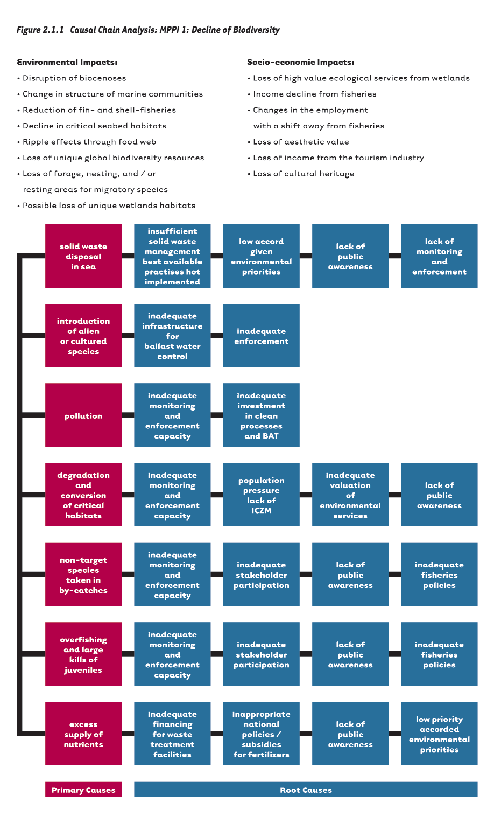
Mediterranean Sea Causal Chain
Ca. 2005

Slide 46
Mediterranean Sea Causal Chains
Lack of detail
No linkage – No logical flow
Lack of detail makes it difficult to interpret
So, could a decision maker translate into action?

Slide 47
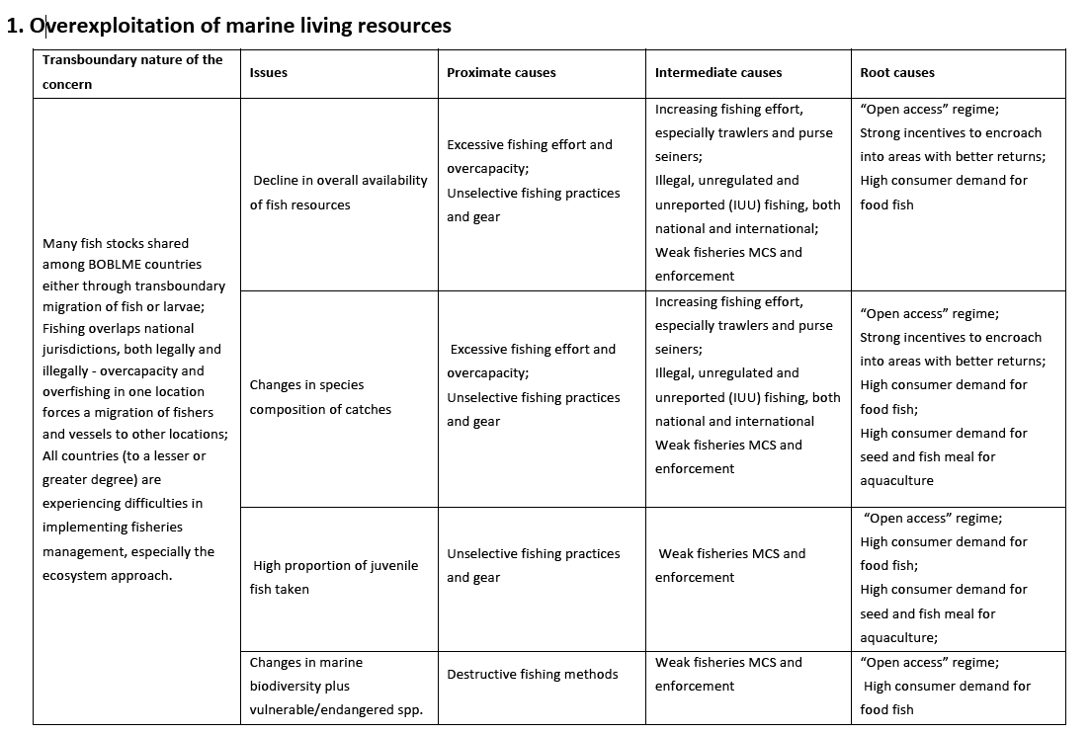
Bay of Bengal LME Causal Chain – Ca. 2011

Slide 48
Bay of Bengal LME Causal Chains
Good level of detail
No linkage but very logical
Links causes to impacts – a good idea
Easy for a decision maker to translate into action

Slide 49
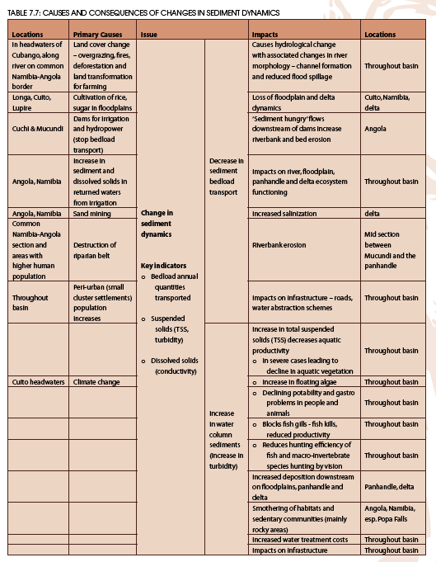
Okavango River Basin Causal Chain – Ca. 2011

Slide 50
Okavango River Basin Causal Chains
Too much detail
No linkage but logical
Links causes to impacts and locations
Confusing for a decision maker to translate into action

Slide 51
Potential difficulties in developing causal chains
CAUSAL CHAIN TYPE | ADVANTAGES AND DISADVANTAGES
Table or matrix (e.g. Bay of Bengal LME) | ✓ Simpler to produce ✓ Conceptually easy for the expert to produce ✗ Difficult to show linkages between causes ✗ Can be conceptually difficult for the reader to understand ✗ Often difficult to identify SAP interventions
Flow diagram (e.g. Kura-Aras River Basin) | ✓ Show linkages between causes ✓ Work well using the sectoral approach ✓ Conceptually easy for the reader to understand ✗ Difficult to construct ✗ Conceptually difficult for the expert to produce ✗ Time consuming ✗ Often difficult to identify SAP interventions

Slide 52
Advice from the Field…..
Time - Do not underestimate the time needed to carry out CCA
Expertise – Ensure that the TDA Development team members working on the CCAs cover all the areas of expertise needed
Preparedness – Try to be well prepared prior to the main causal chain workshop. Have the CCA methodology well developed and understood by key members of the TDA Development team.
Briefing – The CCA process can be difficult for people to conceptualise, so ensure that the Development team are adequately briefed prior to any workshop

Slide 53
Group Exercise
In groups of five:
Take one of the priority transboundary problems (together with its associated environmental and socio-economic impacts and identify:
  The key sectors (e.g. industry, agriculture, fisheries etc) and select one
For that sector, identify:
  The immediate causes
  The underlying causes
  Determine the root causes
Timing: 30 minutes

