Slide 1

IW:LEARN
TDA/SAP Training Course
Module 2: Development of the TDA

Slide 2
Section 9: Drafting the TDA

Slide 3
In this Section you will learn about….
Integrating the component parts of the TDA
What should a TDA look like?
Next Steps in the TDA process

Slide 4
Analysis

Slide 5
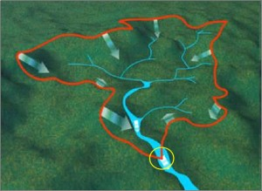

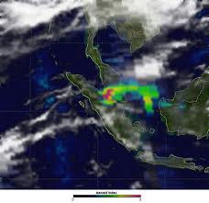

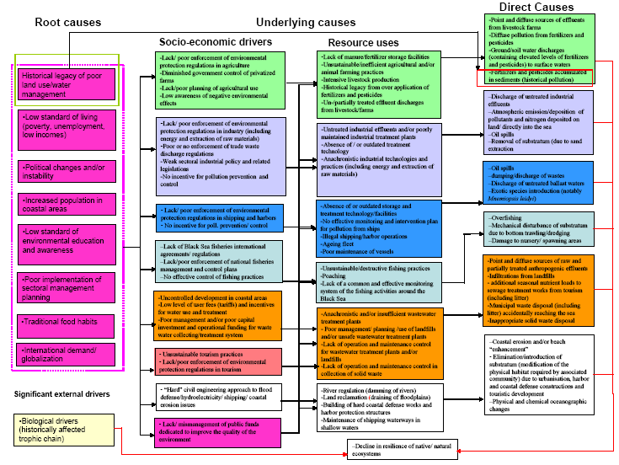

Defining system boundaries
Collection
and analysis of data/information
Identification
&
prioritisation
of the transboundary problems
Determination of the
impacts of each priority problem
Analysis
of the immediate, underlying, and root causes for each problem
Development of thematic reports

Slide 6
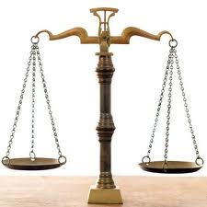




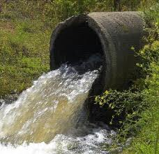
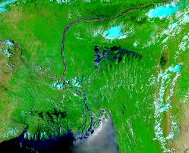

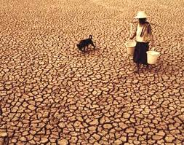
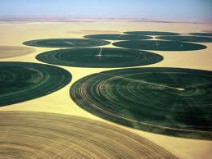
Broader studies on aspects of the TDA
Governance
Analysis
Stakeholder
Analysis
Causal Chain
Analysis
Gender
Analysis
Climate
Change
Specific reports on transboundary problems
Biodiversity
Pollution
Flooding
Fisheries
Drought
Water use

Slide 7
Integration of the component parts of the TDA
All this information now needs to be integrated into one document
The appointment of a consultant, specialist, academic, or a consultancy to act as a single author reporting to the Project Manager
Appointment of key TDA development team members to draft individual Chapters of the TDA, with an appointed Manager acting as a focal point reporting to the Project Manager

Slide 8
Both approaches work…..
Appointing an individual or consultancy to draft the TDA is generally quicker and more efficient but there is a loss of stakeholder involvement and collaboration.
Drafting the TDA using a team can be more demanding on time, funds and energy but is generally a more collaborative process.

Slide 9
What should a TDA look like?
Executive Summary
Decision makers will not read the entire document
Concise and jargon-free
A good executive summary will promote the TDA
The main text
Keep it coherent and concise - an overly long document will be difficult to navigate and interpret
Don’t present too much text or equally too many figures and tables
Supporting data (either figures or tables) can be presented in separate Annexes

Slide 10
What should a TDA look like?
Language
Generally, TDAs are written in the predominant UN language for the region
If the TDA is not written in English, it is likely a translation will be needed
Useful to hire a native English expert to fully edit the translated document
Maps
Use maps to illustrate the geographic scale and scope of the priority transboundary problems
Maps can also be used to show impacted areas and the location of immediate causes (such as hot spots)
Maps can be as simple as line drawings or they can be cartographic or GIS -derived

Slide 11
What should a TDA look like?
Content List
Provide a Content List and a Glossary of all terms employed
Make sure the pages are numbered and the content list numbering corresponds with the page numbering – this is a common and annoying mistake.
Technical Reports
Complex technical reports should be published separately or as annexes.
Acknowledgements
Include a full list of contributing specialists, and annexes containing lists of identified stakeholders.
Approximate size
The size of the TDA will vary from project to project and from water type to water type.
Typically it should be between 80 and 150 pages (plus annexes)

Slide 12
Preliminary recommendations for the SAP
Although the TDA should be objective and should not try to develop solutions (this is the purpose of the SAP), it is acceptable to present a list of preliminary recommendations for the SAP
Be aware though that this is stepping into a more political arena and some for of negotiation might be required

Slide 13
Next Steps – Adoption by the Steering Committee
The draft TDA document should be thoroughly reviewed by the TDA development team and key stakeholders to ensure it is fit-for-purpose and can be adopted by the project steering committee.

Slide 14
Next Steps – Government Acceptance
According the GEF, the TDA should be a non-negotiated document – that is it should be a technical document, agreed to by the TDA development team and the PCU and adopted by the Steering Committee.
However, experience has show that in reality, this is frequently not the case. Often, governments will want to examine and approve the TDA. Although this is not ideal, it is a reality and the project will need to take this into account.

