Slide 1
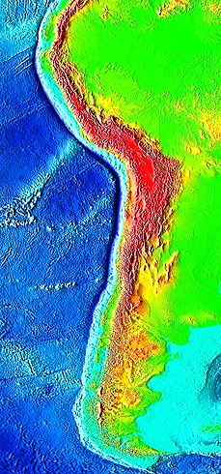
Towards Ecosystem-Based Management of the Humboldt Current Large Marine Ecosystem (HCLME)
= pilot sites
Lima
Summary by
MICHAEL J. AKESTER
Regional Project Coordinator
Santiago
Map Source NOAA
http://www.ngdc.noaa.gov/mgg/image/2minrelief.html
Notes:
Norte de Perú 1) Isla Lobos de Tierra. Centro de Perú 2) Las Islas Ballestas en Reserva Nacional Paracas , cerca de Pisco y 3) Punta San Juan, Ica - cerca de Nazca

Slide 2
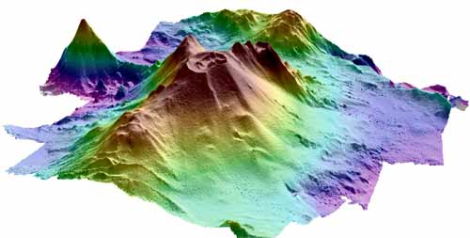
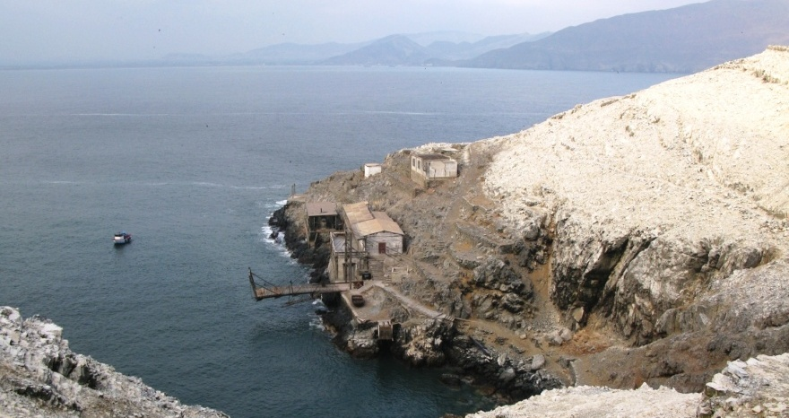
Project Goal: advance towards a sustainably used and resilient HCLME that can maintain biological integrity and diversity and ecosystem services for current and future generations despite changing climatic and social pressures
Objective: Ecosystem-based management in the HCLME is advanced. Four main results:
Result 1 Planning and policy instruments for ecosystem-based management (EBM) of the HCLME are agreed and in place at regional and national levels
Result 2 Institutional capacities strengthened for SAP implementation and for up-scaling pilot interventions to the system level
Result 3 Implementation of priority MPA & fisheries management tools provides knowledge of options for enhanced protection of HCLME and SAP implementation
Result 4 Implementation of pilot MPAs that underpin ecosystem conservation and resilience
Pilot Projects
Seamounts in Chile http://rtseablog.blogspot.com/2010/05/understanding-seamounts-more-study-of.html
Islands, Isles and Guano Capes in Perú
http://rnsiipg.blogspot.com/

Slide 3
EDA = Ecosystem Diagnostic Analysis MPA = Marine Protected Area
TBA = Trans-boundary Analysis
NAP = National Action Plan
SAP = Strategic Action plan
EBM= Ecosystem Based Management
RNSIIPG = Reserva Nacional del Sistema de Islas, Islotes y Puntas Guaneras

Slide 4
What is Ecosystem Based Management?
Ecosystem-based management (EBM) is a term used to describe a balanced way of managing resources while taking the surrounding ecosystem into account.
There is no one definition of EBM, but this definition is widely quoted:
"…ecosystem management is integrating scientific knowledge of ecological relationships within a complex sociopolitical and values framework toward the general goal of protecting native ecosystem integrity over the long term." Grumbine, R. E. “What is Ecosystem Management?” Conservation Biology 8 (1994): pp. 27-38

Slide 5
Ecosystem Based Management and the Humboldt Current Large Marine Ecosystem: Chile - Peru
There are 4 primary categories of ecosystem (nature) services:
Provisioning services are the products obtained from ecosystems, such as food, genetic resources, fiber, and energy.
Regulating services are the benefits obtained from the regulation of ecosystem processes, such as regulation of climate, water, and some human diseases.
Cultural services are the non-material benefits people obtain from ecosystems through spiritual enrichment, cognitive development, reflection, recreation, and aesthetic experience.
Supporting services are ecosystem services that are necessary for the production of all other ecosystem services. Examples include biomass production, production of atmospheric oxygen, nutrient cycling, water cycling, and provisioning of habitat. http://www.ebmtools.org/

Slide 6
The EBM Strategic Action Plan – Roadmap = way to reach the goal
Assess and evaluate all areas or interaction:
1. Nature's Services
2. Scientific Evidence
3. Geographic Scales
4. Ecological Linkages
5. Cumulative Impacts
6. Tradeoffs Among Human Activities
7. Adaptive Management
8. Network of People and Information

Slide 7
1 - Nature’s Services
Which nature's services does the geographic area provide, and where are they produced within the area?
How important or valuable are the nature's services provided in the geographic area?
What nature's services do people want and need from the focal area in the future?
Based on societal values, what quantitative management goal should be set for each type of nature's service in the area?
How might nature's services change in the future under different management scenarios?
Notes:
Biodiversity, food, transport, recreation, water cycle, nutrient recycling, CO2 absorption, temperature regulation
Very important both historically (Guano) and currently: fisheries and biodiversity protection
Food, Recreation, Employment, Energy (wind, wave, biofuel from macro-algae), Oxygen production
Calculate a monetized value for each service or environmental value and calculate the loss if damaged
Sustainable fisheries (co-managed, certified, lower volumes-higher values), energy production (wave power), less pollution, improved tourism, Ecosystem Based Management – land sea interface in place and working

Slide 8
2 - Scientific Evidence
How do species and ecological processes in the focal area generate nature’s services?
How do human activities affect ecosystem services in the focal area?
How much do people value (including market and non-market values) nature’s services from the focal area?
What are the tradeoffs among human activities in terms of their impact on nature’s services?
How can scientific monitoring and models be used to measure key changes in nature's services, outcomes of management actions, and progress toward EBM goals?
Notes:
Upwelling, high primary productivity based on rich nutrient source, trophic web
Positive: MPAs Negative: Pollution (multi-source), overfishing, extraction guano, reduced biodiversity
Most take the services for granted or are unaware what is provided (oxygen): fisheries, recreation, dumping waste, oil exploration, transport etc and are not prepared to directly pay for the services
Fisheries v tourism; oil & gas v fisheries; biodiversity v food. All could coexist but some are prioritized due to their immediate or perceived economic value e.g. Oil & Gas before ecosystem biodiversity
Good baseline data for numbers of species (marine and terrestrial), good choice of indicator species for marine pollution, cost effective data collection methods, trophic models, fisheries management tools, climate change models, oceanographic data collection

Slide 9
3 - Geographic Scales
What are the natural, political, and administrative subareas that make up the focal area, and what role do subareas play in generating nature's services? Examples of subareas are watersheds, bays, and towns.
What are the larger natural, political, and administrative regions in which the focal area is embedded, and how does the focal area contribute in terms of nature's services? Examples of larger areas are biogeographic regions, ocean basins, and nations.
What data are available for integrating across geographic scales to understand the focal area’s natural characteristics and human dimensions?
Which organizations are working on elements of EBM in the subareas or larger regions, and how can they share knowledge, align goals, and take complementary action?
Notes:
a) Natural: area of ocean current upwelling bring nutrients to the surface (photic zone), submerged valleys, submerged seamounts, Islands, Capes, fishing grounds (offshore & nearshore), breeding grounds for marine fish, crustacia, mollusks, birds and mammals – protecting biodiversity. Political: Boarder with Chile (disputed), EEZ, Departmental boundaries (including watersheds); b) Humboldt current = area from Southern Ocean to Equator plus associated upwelling systems. c) Oceanographic, climate change (ENSO), satellite (primary productivity, red tides etc), land sea interface, water quality data and much more; d) Environment Ministries in Peru and Chile, Fisheries Management and scientific research institutions, INGOs (IUCN, WWF and more) – often agencies have overlapping functions

Slide 10
4 - Ecological Linkages
Is there a conceptual model of ecological linkages in the focal area, and is it accessible as a decision-making tool for everyone engaged in EBM?
What are the key ecological linkages that should be given special attention in decision-making?
What tradeoffs and cumulative impacts are suggested by these ecological linkages?
Based on information about ecological linkages, how could policies, regulations, enforcement, and other management practices be changed to sustain nature’s services?

Slide 11
5 - Cumulative Impacts
How do human activities, some of which may seem relatively harmless on their own, combine to impair nature’s services?
How can policies, regulations, enforcement, and other management tools be changed to account for these cumulative impacts and better sustain nature’s services?

Slide 12
6- Tradeoffs Among Human Activities
What direct and indirect tradeoffs occur or could occur among human activities in the focal area?
When a particular human activity occurs and reaps benefits from nature’s services, does it cause other nature’s services to decline?
How could occurrence of one type of human activity affect the viability of other human activities?

Slide 13
7 - Adaptive Management
Can management actions be treated as experiments with the outcomes measured through scientific monitoring?
Can scientific monitoring of nature’s services be used to determine net changes in societal benefits due to management actions?
How can management practices be adjusted as new scientific information enhances our understanding of human impacts and ecosystem function?
Does scientific monitoring show acceptable progress toward EBM goals for nature’s services and net societal benefits? If not, how can management practices be changed to produce better outcomes and make more progress toward the goals?

Slide 14
8 - Network of People and Information
Who are the individuals and groups with a direct or indirect interest in using, appreciating, or sustaining nature’s services from the focal area?
How can these individuals and organizations interact to define a vision for the future and to pursue goals for sustaining nature’s services?
How can they establish, support, and participate in an EBM network that facilitates communication of information, ideas, and viewpoints among diverse individuals and organizations?

Slide 15
Starting now to achieve the following in 2015…

Slide 16
Starting now to achieve the following in 2015…

Slide 17
Starting now to achieve the following in 2015…

Slide 18
Starting now to achieve the following in 2015…

Slide 19
Starting now to achieve the following in 2015…

Slide 20
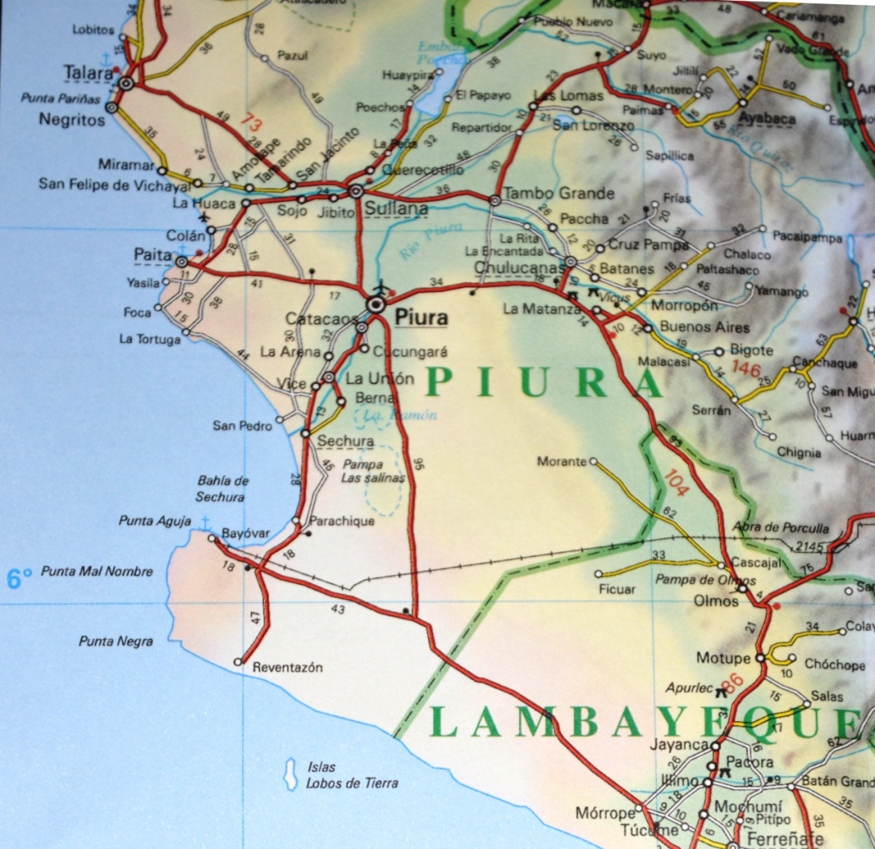
Islands, Isles and Guano Capes representative pilot sites: Isla Lobos de Tierra, Perú

Slide 21
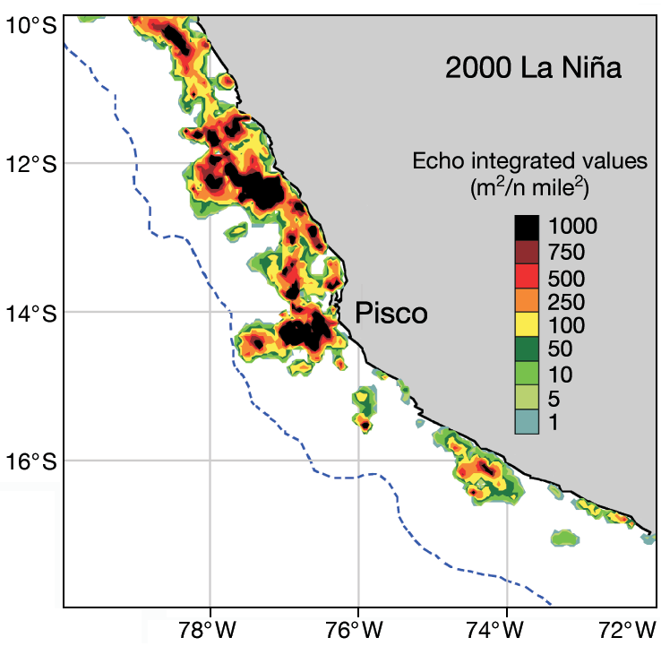
Islands, Isles and Guano Capes representative pilot sites: Las Islas Ballestas, Perú
Fuente mapa:
Changes in diet and maternal attendance of South
American sea lions indicate changes in the marine
environment and prey abundance
Karim H. Soto 1, 2,*, Andrew W. Trites 1, M. Arias-Schreiber 2
1 Marine Mammal Research Unit, University of British Columbia, Room 247, AERL, 2202 Main Mall, Vancouver,
British Columbia V6T 1Z4, Canada
2 Instituto del Mar del Peru (IMARPE), Esquina Gamarra y General Valle S/N Chucuito-Callao, Peru
Islas Ballestas
Distribution e abundancia de anchoveta alrededor de las Islas Ballestas, durante La Niña 2000

Slide 22
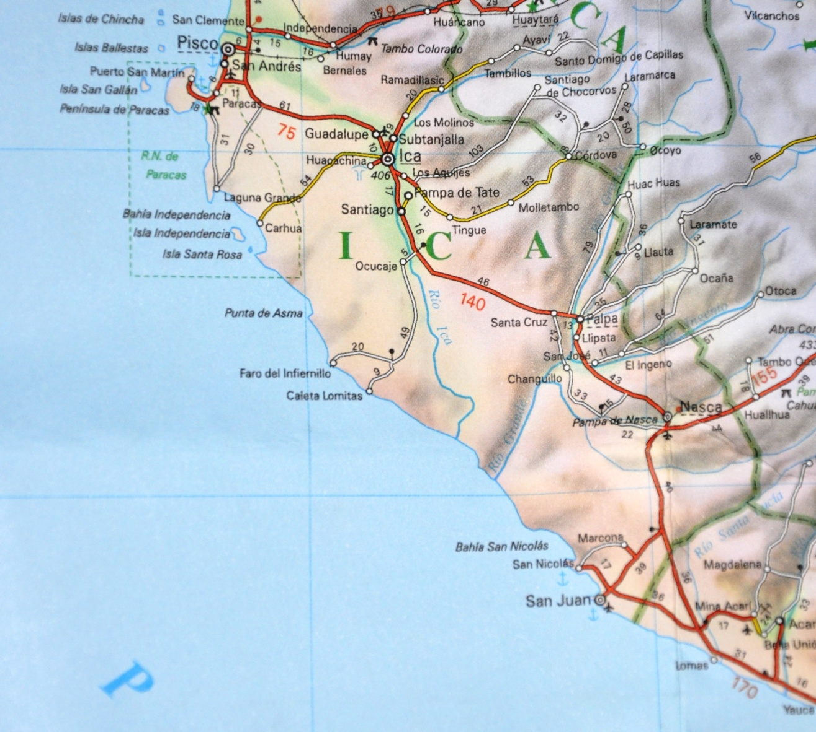
Islands, Isles and Guano Capes representative pilot sites: Punta San Juan, Ica, Perú

Slide 23
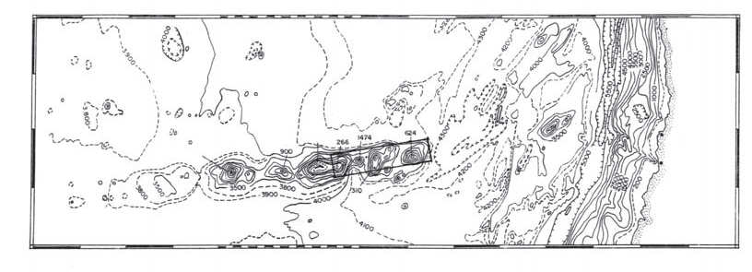
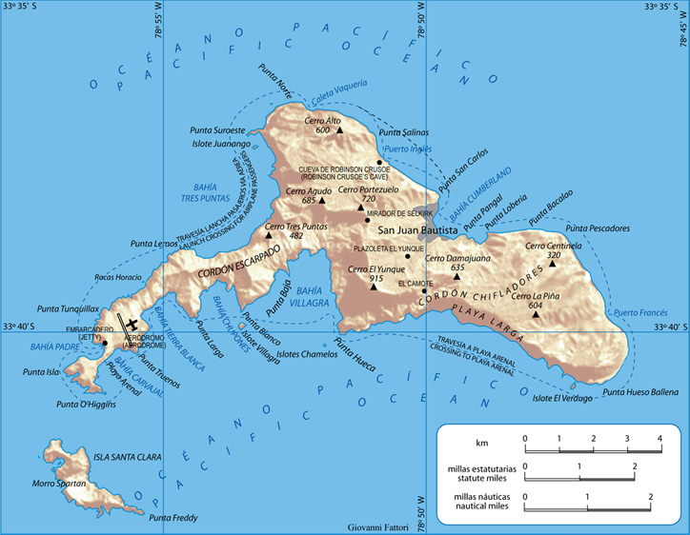
Seamounts in Chile
Islas Juan Fernández: two pilot sites sitios pilotos
Map source:
http://en.wikipedia.org/wiki/File:Rob-cru.png

Slide 24
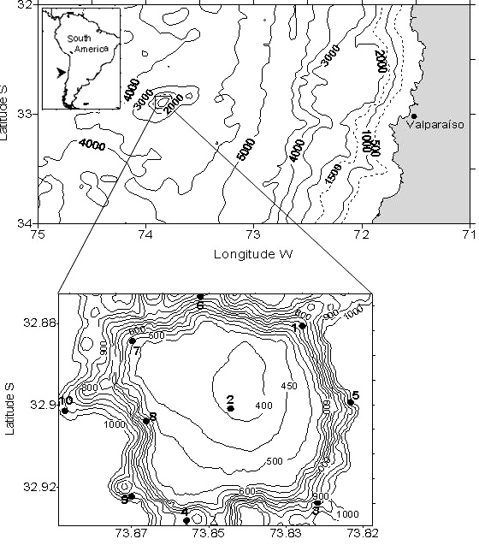
Seamounts in Chile
Bajo O’Higgins: pilot site

